Slide 1


FORUM
OCTOBER 2022
Notes:
Slide Presenter: Neil
In this section you will talk about:
Welcome
Address – haven’t seen you in awhile & wanted to wait until substantive content
Happy to announce the rollout of new ARBuy

Slide 2

Welcome to the
ARBuy October Forum
October 25, 2022
A sign language interpreter is available for this meeting.
If needed, please PIN Makenzie Hunsaker to the top left of your screen.
Click on People from the top Navigation Bar
Locate Makenzie Hunsaker in list of participants
Click on the ellipses (three dots) next to their name
Select Pin for Me

Slide 3
AGENDA
Introductions
Marketplace: Live in Arkansas
Updated ARBuy project phasing
Walmart Marketplace Shopping overview
ARBuy Demo: Purchasing from Walmart through the Marketplace
Supporting the departments and entities
Q&A session
Notes:
Slide Presenter: Neil

Slide 4


INTRODUCTIONS
Presenters
What to expect
Notes:
Slide Presenter: Neil
Presenters:
Neil Greathouse, Communications Director for TSS
Mitch Rouse, Director of the Office of State Procurement
Purchasing Resource? (to demo), title
What to Expect:
We will mute all participants who are joining remotely to ensure a clean recording of today’s session.
If you have a question or a comment, please raise your hand (in person or virtually) or use the chat feature, if joining remotely.
Time permitting, we will answer related topic questions as we go.
After the Forum, a Q&A document will be sent to all participants.
You will also receive both the Power Point Deck for today’s presentation, as well as a link to the recording.

Slide 5
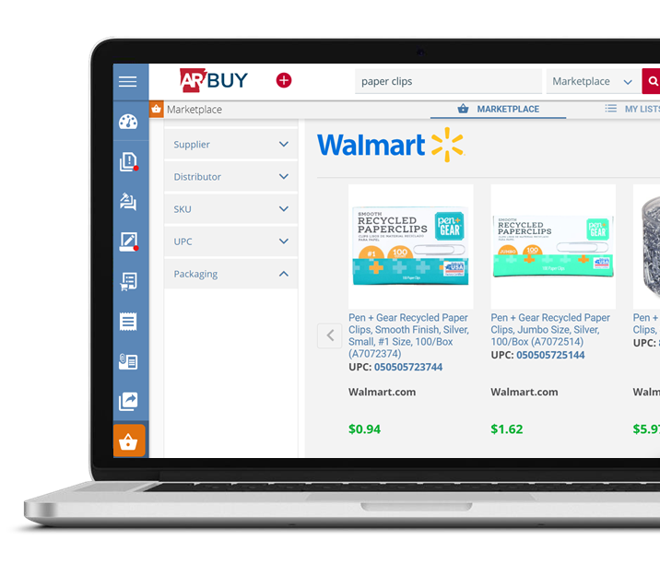
WALMART MARKETPLACE SHOPPING
Arkansas is live with
ARBuy Walmart Marketplace Shopping!
Notes:
Presenter: Secretary Rouse

Slide 6

UPDATED ARBUY WALMART PHASING
Registered Arkansas suppliers in ARBuy
Rolled out sourcing, solicitation and contract management functionality to OSP
Phase I: Spring 2021 - Implemented
Phase II: September 29, 2022
Purchasing from Walmart in Marketplace
Walmart Marketplace functionality rolling out in four phases:
  First phase of rollout is live
  Final three phases to rollout by mid-November
Notes:
Slide Presenter: Secretary Rouse --- Complete by end of year according to state: Walmart fully live for state and locals, contract browsing fully live by end of year. (Phyllis FYI this means we are working with vendors to upload visually appealing catalogs from vendors)

Slide 7
WALMART MARKETPLACE SHOPPING
Walmart Shopping
  Easily add Walmart items to Marketplace shopping cart
    Quickly convert shopping cart items to an ARBuy requisition
    Automatically route Walmart ARBuy requisition to appropriate approvers
    Conveniently pay for your Walmart purchase with a P-Card
    Electronically transmit purchase order (PO) to Walmart from ARBuy
.
Notes:
Presenter: Neil

Slide 8
DEMO: PURCHASING FROM WALMART THROUGH MARKETPLACE
  Scenario:
    Add details of scenario here…
Walmart purchase through Marketplace
Notes:
Presenter: TSS Purchasing Resource?

Slide 9

BENEFITS TO STATE OF PURCHASING THROUGH ARBUY
Benefits now:
  Greater visibility to state spend
  Enables strategic purchasing decisions
  Provides increased transparency
In the future:
  All of the above, plus…
    Guarantees negotiated contract pricing
    Levels playing field for all vendors
Notes:
Slide Presenter:Neil

Slide 10


SUPPORTING THE DEPARTMENTS AND ENTITIES
ARBuy training is provided with online learning curriculum and job aids through MYARCAREERS.
Walmart Marketplace Shopping
Total Training Hours: 1 – 1.5 hours
4 online courses – 10-15 minutes each. Covering basic navigation, searching, shopping and editing user information.
4 job aids – Downloadable covering ARBuy login and passwords, as well as other useful information.
For Document Approvers ONLY
1 online course – 4 minutes. Covering ARBuy document approvals.
1 job aid – Downloadable covering approving and disapproving documents.
Notes:
Slide Presenter: Neil

Slide 11

SUPPORTING THE DEPARTMENTS AND ENTITIES
Focused support available through Virtual ARBuy office hours.
Virtual ARBuy office hours are available:
Monday Oct. 31, 1:00 pm – 2:30 pm
Wednesday Nov. 2, 10:00 am – 11:30 am
These sessions are highly encouraged.
Attend from the beginning to see a live demo.
Otherwise, drop in at any time during the session to get your ARBuy questions answered.
The Office Hours link will be emailed to activated users by TSS.
LEARNING
SUPPORT
Notes:
Slide Presenter: Neil As more users are activated, more virtual office hours will be presented and shared via TSS

Slide 12
SUPPORTING THE DEPARTMENTS AND ENTITIES
Resources for assistance:
Periscope user help desk:
  epro-support@periscopeholdings.com
  Phone # 1-888-472-9102
ARBuy project website: www.periscopeholdings.com/arbuy
Notes:
Slide Presenter: Neil

Slide 13


Q&A
Notes:
Slide Presenter: Neil

Slide 14


THANK YOU!
Notes:
Slide Presenter: Neil

