Slide 1
How to Access Self Paced Online Training
MyARLearning

Slide 2
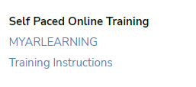
MYARLEARNING
Click the “ MYARLEARNING” Link
Under “Self Paced Online Training”

Slide 3
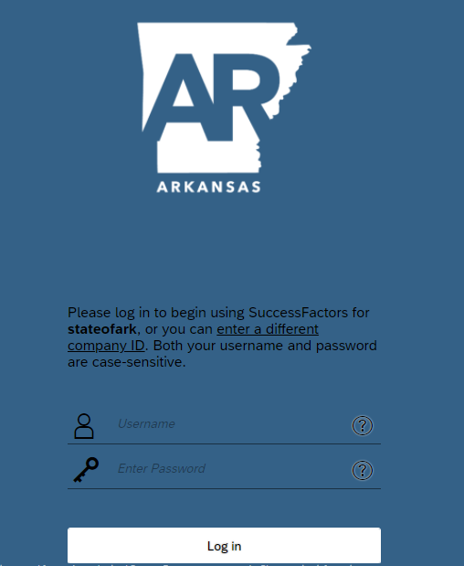
MyARLearning
MyARLearning is a web-based application that allows you to take courses established for the State of Arkansas.
The MyARLearning application can be accessed using you MyARCareers Username and Password.
The link to MyARLearning is as follows:
SuccessFactors Log in (sapsf.com)
If you have any questions or need help using the ARCareers Website, please contact the Office of Personnel Management at 501-682-8197 or 501-682-1753, or email us at arcareers@arkansas.gov.

Slide 4
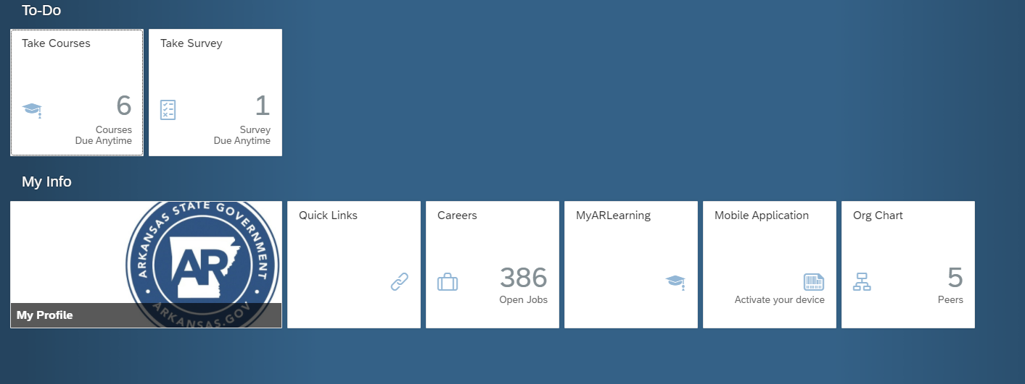
MyARLearning
Click the “MyARLearning” tile from your profile screen

Slide 5
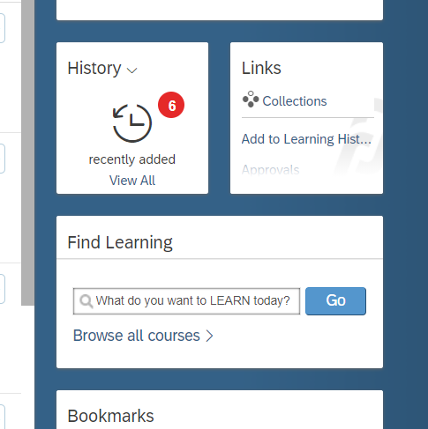
Training Courses
Training Courses can be found using the Find Learning search tool.
In the search bar for:
Purchase or Travel Card Training- enter “Card”
Reviewer Training - enter “Reviewer”

Slide 6
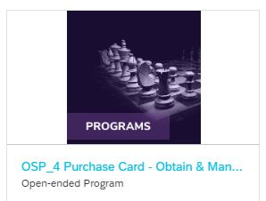
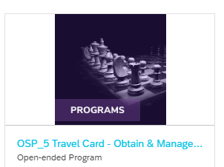
Training Courses
Choose the following Courses that apply:
Purchase Card – Obtain & Manage Certification
Travel Card – Obtain & Manage Certification
Credit Card Reviewer

Slide 7
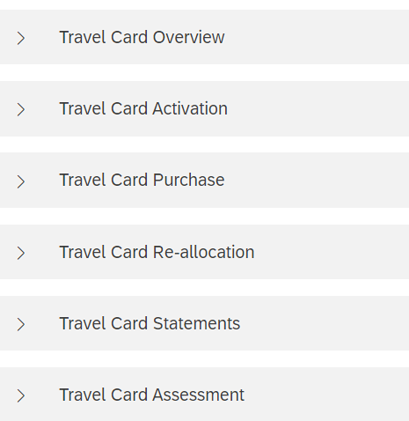
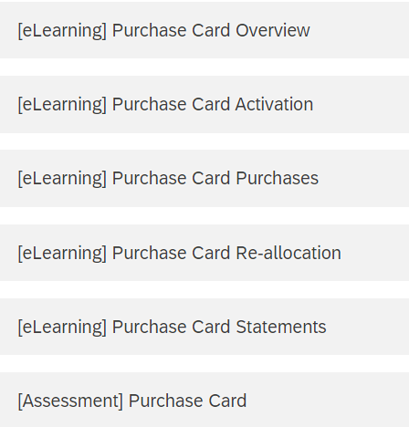
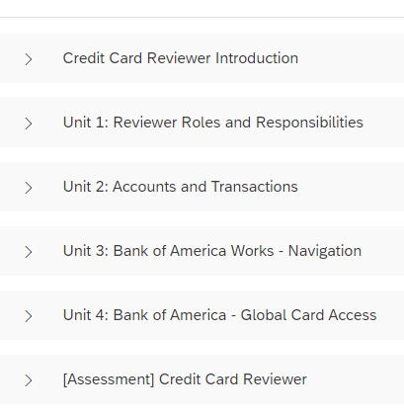
Course Sections
Travel Card or CTS
Purchase Card
Reviewer
The training Course will be broken down into sections. Each section must be completed prior to receiving a credit card or access.

Slide 8
Completing Assessment
Upon completion of the Card Assessment, you will need to print your certificate.
The certificate must be submitted with your application.
From the Course Screen:
Click Review Content

Slide 9
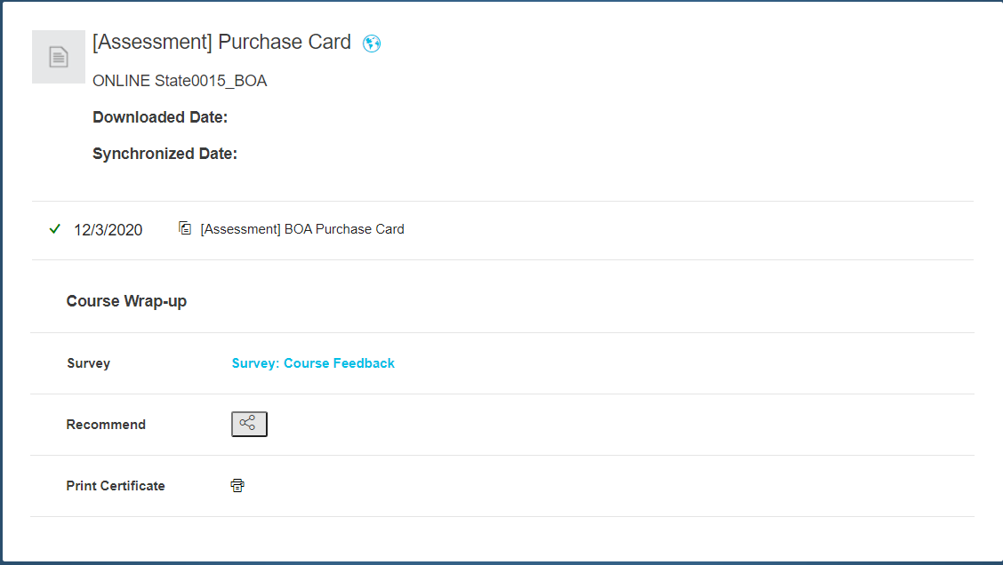
Print Certificate
The Review Content Screen provides the following:
Type of Training
Date the course was completed
Survey Option
Print Certificate Icon
Click Print Certificate
The certificate must be printed and attached to your Credit Card Application

