Slide 1
HIPAA In The Workplace
What Every Employee Should Know and Remember

Slide 2
What is HIPAA?
The Health Insurance Portability and Accountability Act of 1996
  Portable
  Accountable
  Rules for Privacy
  Rules for Security
  Final HIPAA Omnibus Rule of 2013
  http://www.hhs.gov/ocr/privacy

Slide 3
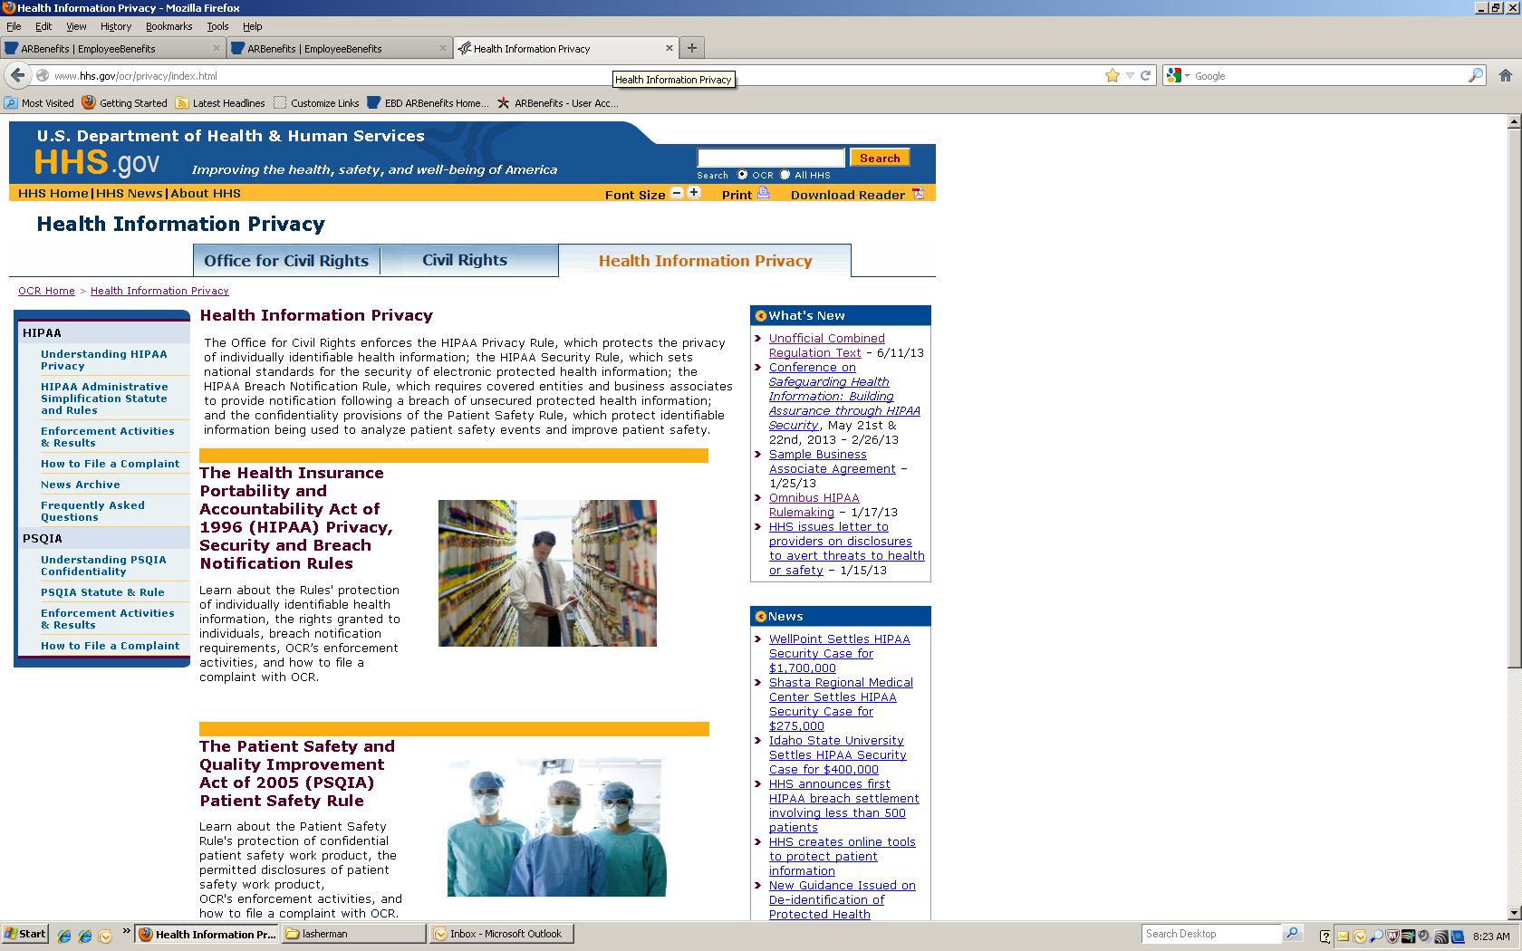

Slide 4
Privacy Effective Dates:
April 14, 2003
  Privacy Rules effective this date
  Compliance Date
  Regulations enforced by the Office of Civil Rights

Slide 5
What is the Privacy Regulation?
Intention of the regulation is to protect health information from non-medical uses by employers, marketers, etc.
Regulate access to individuals’ health information including the PHI of a deceased individual for a period of 50 years following the date of death
Information that is not in electronic format is protected under the Privacy Regulation

Slide 6
What is Protected Health Information (PHI)?
PHI is information, whether oral or recorded in any form or medium, which relates to:
  The individual’s past, present or future physical or mental health or condition
  The provision of health care to the individual
  The past, present or future payment for the provision of health care to the individual
  And is created or received by health care provider, health plan, public health authority, employer, school or university, health care clearinghouse or state agency.

Slide 7
What makes it personally identifiable?
Demographic data collected about an individual that could reasonably be used to identify the individual
  Name, Address, Zip Code, Telephone Number, Email Address, Birth Date, Age, Photo, Finger and Voice Prints, Education Level, Job Classification, Job Tenure, Social Security Number, Account Numbers, Certification Numbers, License Numbers, etc.
  When combined with health information such as patient ID#s, medical records, diagnosis, disability codes, lab reports, claims, medical bills, etc.

Slide 8
Where will you see PHI?
AASIS/ABSCAN
Authorization Forms or Authorization Requests
Change Forms
Election Forms
FMLA (Family Medical Leave Act) Requests
Member Records (in ARBenefits)
Reports and Invoices

Slide 9
Who must comply with the HIPAA Regulations?
Hospitals, medical clinics, physician offices, pharmacies, dentists, chiropractors, private companies, insurance companies, health care clearinghouses, schools, universities and state agencies
Employee Benefits Division of the Department of Finance and Administration and Our Business Associates

Slide 10
Am I a Business Associate?
If you are authorized to do business (create, receive, maintain, or transmit PHI) with EBD or other Covered Entities: you are a Business Associate (BA)
  Business Associates are subject to all provisions of HIPAA Omnibus Rules
  Business Associates are subject to the same Civil and Criminal Penalties as EBD and other Covered Entities

Slide 11
Business Associates
  BAs are now directly liable under the HIPAA rules:
  For impermissible uses and disclosures
  For failure to provide breach notification to EBD
  For failure to provide access of Electronic PHI either to the individual or EBD
  For failure to disclose PHI to the Secretary of HHS
  For failure to provide an accounting of disclosures
  For failure to comply with the requirements of the HIPAA Privacy and Security Rules
  BAs must comply with the "Minimum Necessary" principle

Slide 12
Business Associate Agreement
Covered Entities are required to obtain a Business Associate Agreement (BAA) i.e. "satisfactory assurances” that their PHI will be protected as required by HIPAA rules from their BAs.
EBD will establish guidelines to periodically monitor BA performance to ensure compliance with the BAA
If a breach or violation occurs or is discovered, the BAA will define the steps to solve the problem, terminate the agreement, and report the offense to the Secretary of HHS/Office of Civil Rights

Slide 13
Subcontractors: Business Associates ?
  Business Associates are responsible for oversight of their Subcontractors who create, receive, maintain, or transmit PHI on behalf of a Business Associate (BA)
  Subcontractors who create, receive, maintain, or transmit PHI on behalf of a Business Associate are now HIPAA Business Associates of that Business Associate and are subject to the same Civil and Criminal Penalties as Covered Entities and other Business Associates
  BAs must have a BAA with their Subcontractor HIPAA Business Associates. If you are a current BA who subcontracts any EBD/health related information, a copy of your HIPAA compliant BAA must be on file with EBD

Slide 14
PHI Permitted Uses and Disclosures:
You must have a signed authorization in order to disclose PHI for any use or disclosure that is not related to treatment, payment or healthcare operations
You must identify employees within your organization who may receive or disclose PHI

Slide 15
PHI Permitted Uses and Disclosures:
You must only divulge the minimum necessary information to complete the task or request- uses or disclosures that violate the "Minimum Necessary" principle may qualify as breaches and should be reported
You must have an effective mechanism to resolve employee non-compliance (policies and procedures) and all staff must be aware of these policies and procedures

Slide 16
Who is responsible for authorization, and when do we need it?
Authorization is required for any use or disclosure to anyone other than the individual that is not related to treatment, payment or healthcare operations related activities
  Entity that has the information must have the authorization PRIOR to disclosure

Slide 17
HIPAA Security Effective Dates:
Effective April 14, 2005
  Security Rules effective this date
  Compliance Date
  Regulations enforced by the Office of Civil Rights as of August 3, 2009

Slide 18
What is the Security Regulation?
Ensures confidentiality: electronic PHI is not made available or disclosed to unauthorized persons or processes;
integrity: electronic PHI has not been altered or destroyed in an unauthorized manner;
access: the ability or the means necessary to read, write, modify, or communicate data/information or otherwise use any system resource of all electronic PHI and;
availability: information is accessible and useable upon demand by an authorized person of electronic PHI, of all electronic PHI created, received, maintained, or transmitted
Protects against any reasonably anticipated threats, hazards and uses or disclosures that are not allowed by Privacy regulations

Slide 19
What is the Security Regulation?
No unauthorized uses or disclosures under Security
Evaluate and review role based access and documentation periodically, and update as needed, in response to environmental or operational changes affecting the security of electronic PHI
Amend policies, training and Notice of Privacy Practices as needed
Encrypt all electronic data and information systems

Slide 20
What is the Security Regulation?
Perform/update Risk Assessments and Disaster Recovery Activities in response to environmental or operational changes affecting the security of electronic PHI
Mitigate and reduce threats to electronic PHI by whatever safeguards are reasonable and appropriate to the implementation of the Security regulation
Document all Security Regulation Safeguards and efforts so your agency/school is ready for: Audit by Secretary of HHS or EBD

Slide 21
What makes it electronic PHI?
Electronic PHI (ePHI)- PHI transmitted or maintained on electronic media:
  Electronic storage media, including memory devices in computers, flash drives, cd’s, dvd’s, external hard drives, scanners, PDAs, smart phones and fax machines
  Transmission media used to exchange information already in electronic storage media, such as email
  Certain transmissions, including paper via fax, and voice are not considered transmissions via electronic media unless an electronic copy is made to an internal hard drive of the device when the document is transmitted

Slide 22
Genetic Information Non-Discrimination Act (GINA)
Title I part of Privacy Rule as of October 2009
Can not use Genetic Information to discriminate for basis of health insurance enrollment or underwriting

Slide 23
G.I.N.A.: Title II
Title II part of Privacy Rule
Can not use Genetic Information to discriminate in employment decisions
G.I.N.A. also restricts employers’ acquisition of genetic information and limits disclosure of genetic information

Slide 24
G.I.N.A.: Title II
Protects job applicants and employees against discrimination based on genetic information in hiring, promotion, discharge, pay, fringe benefits, job training, classification, referral and other aspects of employment
Makes it illegal to harass a person in the workplace because of his or her genetic information

Slide 25
What does HIPAA allow us to do?
Treatment- the provision, coordination, or management of health care and related services by one or more health care providers
Payment- activities undertaken to obtain premiums or to obtain or provide reimbursement for the provision of health care
Operations- activities that are related to functions such as management and general administrative activities such as customer service, reporting, case management, utilization review, etc.

Slide 26
Unsecure PHI
PHI in any medium (electronic, paper or oral) that is not secured through use of a technology or methodology that renders PHI unusable, unreadable, or indecipherable to unauthorized individuals
Only forms of “secure” PHI are encryption, shredding (cross-shredding), or destruction

Slide 27
What is a Breach?
Anything that compromises the security or privacy of protected health information (PHI) and is
  An unauthorized acquisition, access, use, or disclosure of PHI
  An impermissible use or disclosure of PHI is presumed to be a breach
  Uses or disclosures that violate the "Minimum Necessary" principle may qualify as breaches and such incidents must be evaluated like any other security incident

Slide 28
What do I do If I think a Breach has Occurred?
Contact EBD (Compliance Officer) as soon as you receive notification or become aware of the breach (no later than next business day of breach discovery)
You must provide the identity of each individual whose unsecured PHI has been or is reasonably believed to have been breached as well as all details involving the breach (who, what, where, when, how)
Go to ARBenefits; scroll to bottom of page and click “HIPAA”. You are at the HIPAA Library where the HIPAA Disclosure Reporting form (breach reporting form) is located; complete form and provide copies of supporting documentation; return to Compliance Officer at EBD

Slide 29
Business Associate Breaches
Business Associates (BAs) must provide the following concerning breaches/potential breaches:
Identify the nature of the unauthorized use or disclosure or security incident
Identify the PHI used or disclosed
Identify who made the unauthorized use or received the unauthorized disclosure
Identify what BA has done or will do to mitigate any deleterious effect of the unauthorized use or disclosure
Identify what corrective action BA has taken or will take to prevent future similar unauthorized use or disclosure
Provide such other information, including a written report, as reasonably requested by Covered Entity (EBD)

Slide 30
Individual Breach Notification
Covered Entities and Business Associates must mitigate harm to individuals through Individual Breach Notifications
The Notification must describe type(s) of PHI that were or may have been involved in the breach
The Breach Notification must describe the steps that are being taken to mitigate potential harm resulting from the breach and that such harm is not limited to economic loss

Slide 31
Individual Breach Notification
The Breach Notification must give contact procedures for individuals to ask questions or learn additional information, including a toll-free telephone number, an e-mail address, web site or postal address
It should also identify the level of potential harm to the individual so they can better protect themselves-such as determining to pay for credit protection, etc.

Slide 32
Most Frequent Complaints:
Lack of adequate safeguards- Computers not encrypted, PHI not secured, PHI improperly disposed of, employees not HIPAA trained, Authorizations for Disclosure of Medical Information not completed/in place, lack of physical safeguards, employees accessing information in an inappropriate manner (being a Lookie-Lou)
Disclosures not limited to “minimum necessary” standard- can be a breach now

Slide 33
What Happens with Non-Compliance?
VIOLATION TYPE | EACH VIOLATION | REPEAT VIOLATIONS PER CALENDAR YEAR
Did Not Know /Unknowing | $100 – $50,000 | $1,500,000
Reasonable Cause | $1,000 – $50,000 | $1,500,000
Willful Neglect – Corrected | $10,000 – $50,000 | $1,500,000
Willful Neglect – Not Corrected | $50,000 | $1,500,000
The $1.5 million is not a comprehensive maximum fine for a given category per year. There is no theoretical maximum fine per year or incident. The maximum will be at the discretion of HHS and is dependent on how many different kinds of violations and the number of same kind of violations that are found during an investigation.

Slide 34
What Happens with Non-Compliance?
Did Not Know/Unknowing. EBD or BA did not know and reasonably should not have known of the violation
Reasonable Cause. EBD or BA knew, or by exercising reasonable diligence would have known, that the act or omission was a violation, but EBD or BA did not act with willful neglect
Willful Neglect – Corrected. The violation was the result of conscious, intentional failure or reckless indifference to fulfill the obligation to comply with HIPAA. However, EBD or BA corrected the violation within 30 days of discovery
Willful Neglect – Uncorrected. The violation was the result of conscious, intentional failure or reckless indifference to fulfill the obligation to comply with HIPAA, and EBD or BA did not correct the violation within 30 days of discovery

Slide 35
Criminal Penalties
Wrongful disclosure or obtainment: up to $50,000 and up to one (1) year imprisonment or both
Offenses committed under false pretenses: up to $100,000 and up to five (5) years imprisonment or both
Offenses committed with the intent to sell, transfer or use PHI for commercial advantage or personal gain or malicious harm permit fines of up to $250,000 and up to ten (10) years imprisonment or both

Slide 36
Attorney General Prosecution
The State Attorney General has the authority as of February 2009 to bring civil actions on the behalf of state residents to stop violations and/or obtain damages of $100 per violation not to exceed $25,000 per year for identical violations
State can recover attorney fees in any civil action to collect damages

Slide 37
Attorney General Prosecution
Upon petition of the Attorney General, the court may order suspension or forfeiture of licenses, permits or authorization to do business in this state
This action would be taken in cases of Willful Neglect;
Not Corrected

Slide 38
As a Supervisor- What can you do?
You can ask, “Why aren’t you coming to work today?”
You can request additional information, “Will you be back to work tomorrow or be out for the week?”
You must protect that information
Information can be shared vertically (only with your boss, but not your co-workers or other employees)

Slide 39
4 ways to secure your workstation
Lock up- file cabinets, desks, doors
Always Log out of your Systems completely
Disable your drives (done by Tech Support)
Make Security a part of your Routine
    If it is PHI- It is Protected!!!

Slide 40
Ways to eliminate unauthorized use
Use workstation ID’s and passwords
Never share your workstation ID’s or passwords
Do not leave your workstation ID’s or passwords on your monitor, under your keyboard or telephone
Use screen savers-but not Web imported ones; they are full of Spyware and other malware
Position your monitor away from doorways and windows
Do not take PHI paperwork with you to the bathroom

Slide 41
If you have any doubt whether HIPAA applies:
Don’t say anything, or say the minimum necessary
Contact your supervisor
Contact EBD’s Compliance Department

Slide 42
Procedural Safeguards:
Visits to secured areas should be limited to business purposes only
NEVER recycle anything containing PHI
ALWAYS shred PHI (including cd’s and dvd’s)
Be careful with faxed data – it is the most at risk for breach of privacy

Slide 43
Procedural Safeguards:
Employee Benefits Division Workforce
If you work at EBD, you are part of the EBD Workforce
Be familiar with EBD’s policies and procedures and utilize them to ensure you are following HIPAA laws, as well as EBD’s rules and processes
EBD’s policies and procedures are located in ARBenefits under Administration/Policies and Procedures and can be found by department (catalog), subject, title or number (search)
All Privacy and Security policies and procedures apply to all EBD Workforce. You are required to read and be familiar with these policies and procedures

Slide 44
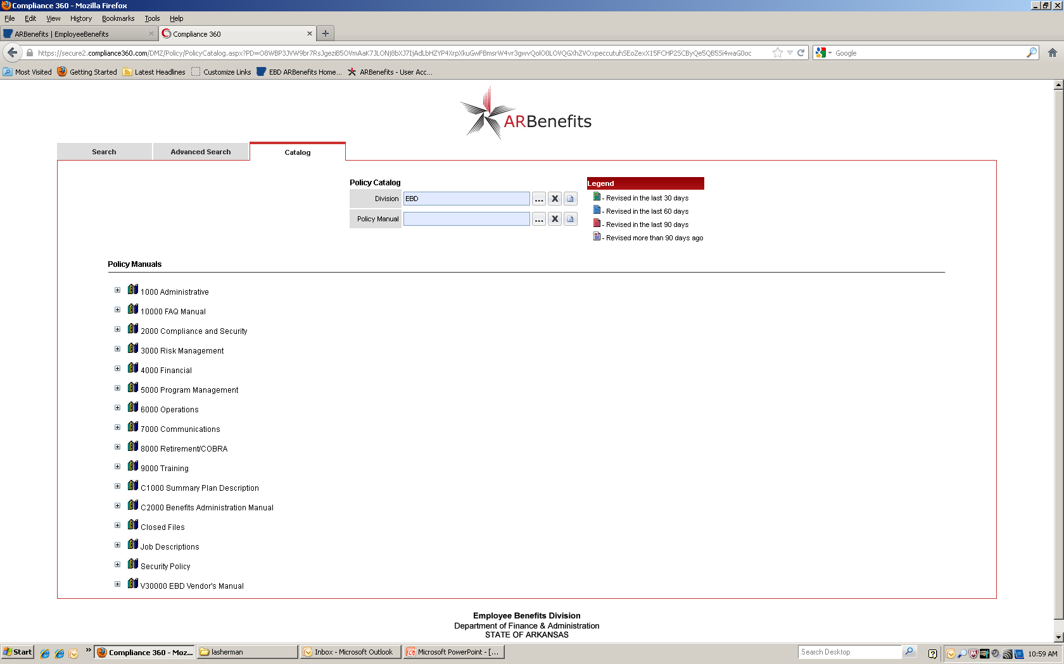
Compliance 360 Catalog

Slide 45
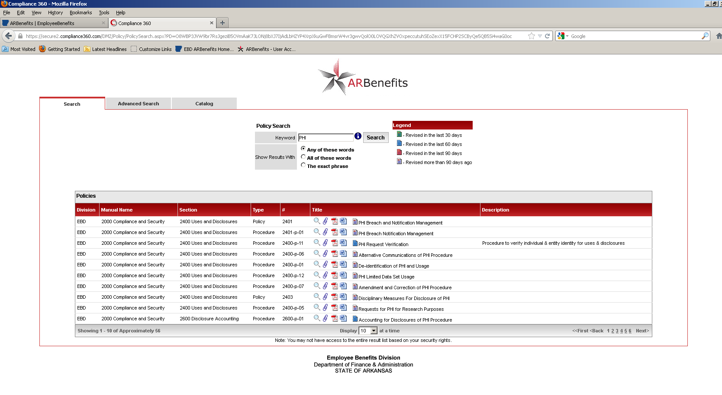
Compliance 360 Search

Slide 46
Fund Raising
The HIPAA Final Omnibus Rule allows fundraising but has strengthened opt-out provision
Employee Benefits Division does not participate in or allow any fundraising
Employee Benefits Division does not allow any member information to be released for any fundraising purpose

Slide 47
Marketing
Employee Benefits Division does not permit the marketing or sale of any member information
Employee Benefits Division does not permit marketing to any members
Any communication about a product or service that encourages purchase or use is marketing
If remuneration is received from a third party whose item or service is described it is marketing

Slide 48
Sales of PHI- Prohibited
Covered entity (EBD), its Business Associates and Subcontractors may not receive remuneration in exchange for Protected Health Information

Slide 49
HIPAA Final Omnibus Rule
The final Omnibus Rule became effective on March 26, 2013
  Go to www.hhs.gov/ocr for full information

Slide 50
Security Questions
If I do not object, can my health care provider share or discuss my health information with my family, friends, or others?
Can my Doctor or Nurse discuss my health information or condition with my brother, sister, or parents if I tell them not to?

Slide 51
Security Examples
Wal-Mart
Anne Presley’s Medical Record (6 Employees dismissed from St. Vincent's)
NW AR Nurse received 2 years probation and 100 hours community service

Slide 52
Security Examples
Phoenix Cardiac Surgery Center
BlueCross/Blue Shield of Tennessee: First HITECH Settlement
A psychiatrist from New Hampshire was fined $1,000 for repeatedly looking at the medical records of an acquaintance without permission

Slide 53

Questions?

