Slide 1
PCS & TGS OVERVIEW

Slide 2
PCS/TGS TRAINING COURSE CONTENT
1.1 TGS/PCS Paperwork
1.2 Services Portal

Slide 3
Introduction
ACA §19-11-203 (27) (A); 19-11-274 (a); 19-11-265 (a)
Services means the furnishing of labor, time, or effort by a contractor that does not produce tangible commodities.
A contract for services shall be reported if the total initial contract amount is at least twenty-five thousand dollars ($25,000) but less than an annual contract amount of fifty thousand dollars ($50,000) in any one (1) contract year or a total projected contract amount is less than three hundred fifty thousand dollars ($350,000).
A contract for services shall be reviewed if the annual contract amount is at least fifty thousand dollars ($50,000) in any one (1) contract year or if the total projected contract amount, including any amendments or possible extensions, is at least three hundred fifty thousand dollars ($350,000).
In this training we will provide information in the following areas to complete a service portal entry.
  AASIS
  PAPERWORK
  PORTAL

Slide 4
KNOWLEDGE Check
True or False: Services are defined as the furnishing of labor, time, or effort by a contractor that does not produce tangible commodities. True False

Slide 5
KNOWLEDGE Check
True or False: Services are defined as the furnishing of labor, time, or effort by a contractor that does not produce tangible commodities.
  True
    Professional services are defined as services rendered under a professional services contract are rendered to the state agency itself or to a third-party beneficiary; The state agency does not have direct managerial control over the day-today activities of the individual providing the services.
    Technical and general services are defined as work accomplished by skilled individuals involving time, labor, and a degree of expertise in which performance is evaluated based upon the quality of the work and the results produced.

Slide 6
PCS/TGS PAPERWORK
TGS/PCS Paperwork
  Completion of the SRV-1 & SRV-1A
  Additional Documentation Required

Slide 7


Services contract (SRV) FORM
WHICH FORM SHOULD I USE?
This Photo by Unknown Author is licensed under CC BY-NC

Slide 8
SRV-1 AND SRV-1A
THE SRV-1 form (formerly known as PCS/TGS-1) should be completed for original (new) contracts
THE SRV-1A form (formerly known as PCS/TGS-1A) should be completed for amendments.
Use the link below to access these forms, instructions, helpful resources, etc.
Services - Arkansas Department of Transformation and Shared Services

Slide 9
KNOWLEDGE Check
Which Services form is used for original contracts? SRV-1 SRV-1A

Slide 10
KNOWLEDGE Check
On an original contract you must use the
  SRV-1
      The SRV-1A form is used with amendments or renewals.

Slide 11
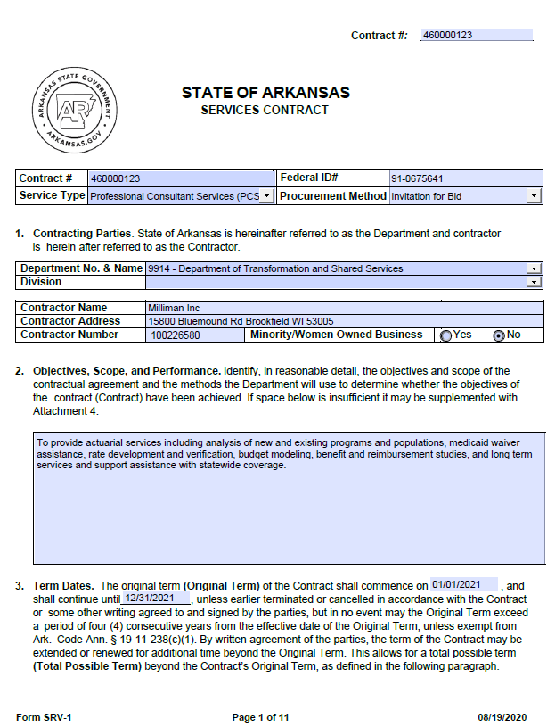
SRV-1 form
Must be completed for original contracts submitted to the portal.
Services-Contract-SRV-1-Instructi vice
COMPLETING THE SRV FORM
COMMON ERRORS:
The contractor number is the AASIS vendor number, not the contractor’s phone number.
The original term of the contract may not exceed four consecutive years from the effective date of the contract. ACA §19-11-238
The maximum extension date may not exceed seven years. ACA §19-11-238
Notes:
Instructions for completing the fields are provided on the OSP website under the Services section - Services-Contract-SRV-1-Instructions.pdf (ar.gov)

Slide 12
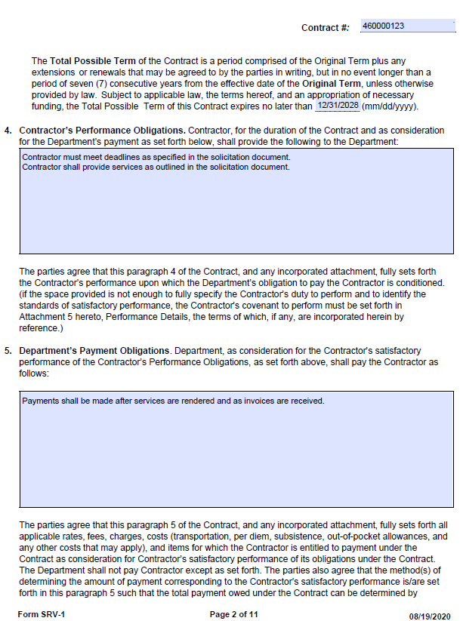
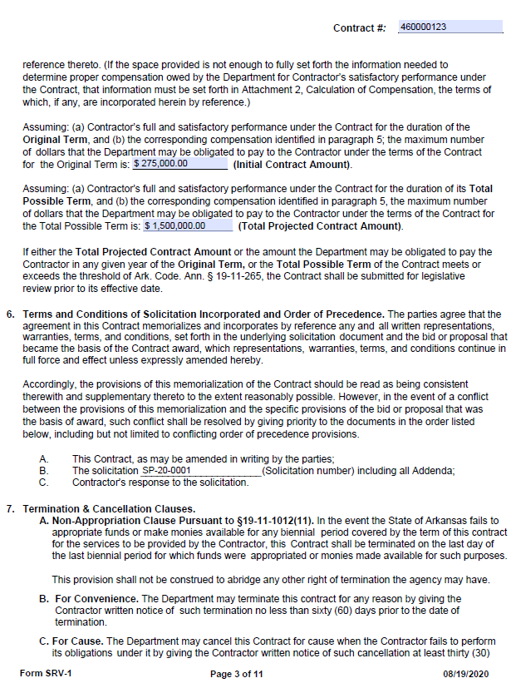
Notes:
Contractor’s Performance Obligations: This should include acceptable performance standards.
Department’s Payment Obligations: This should include the agency’s payment schedule or other payment obligations.
Initial Contract Amount: This should equal the total line items in AASIS and the target value.
Total Projected Amount: This should include the initial amount plus any potential amendments and extensions.
Solicitation Number: This is the identifying characters assigned to the solicitation document.

Slide 13
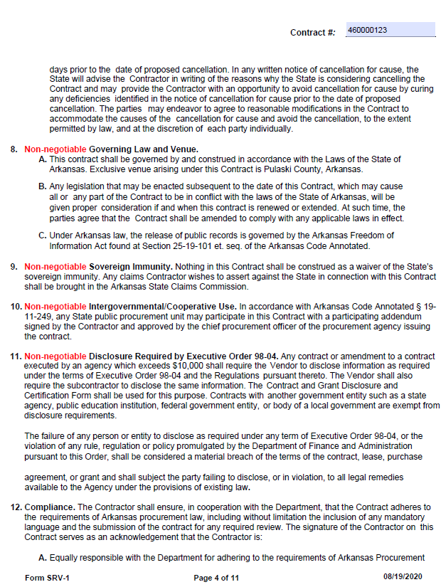
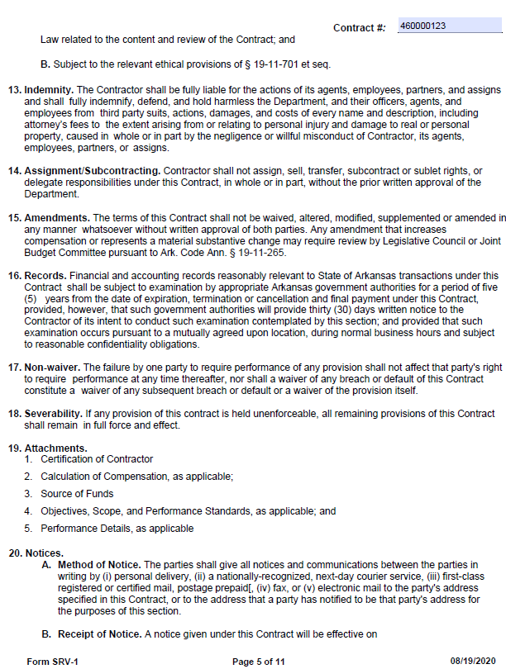
Notes:
Pages 4 & 5 include standard contract language. No fields required for entry.

Slide 14
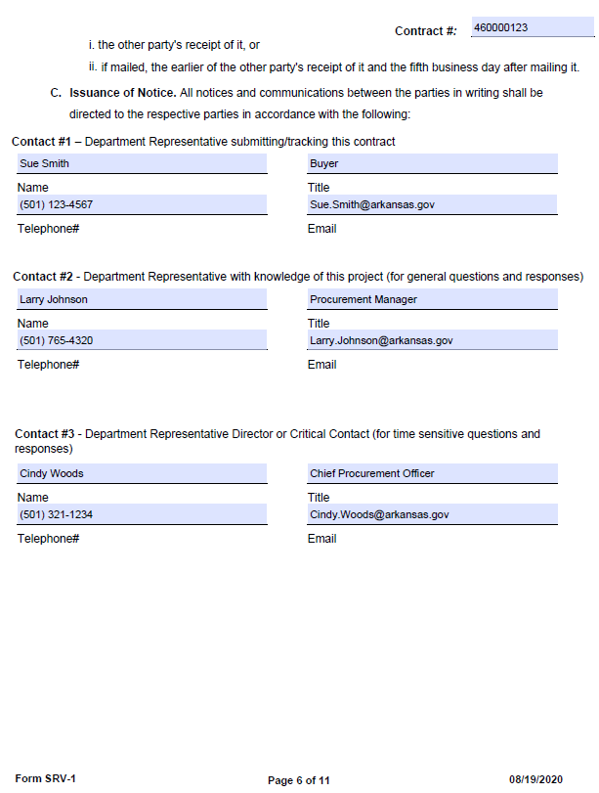
AGENCY CONTACT INFORMATION
Contact information must be provided in case there is a question concerning the contract.
Notes:
Contacts should be listed in the order which they should be contacted in the event of questions.

Slide 15
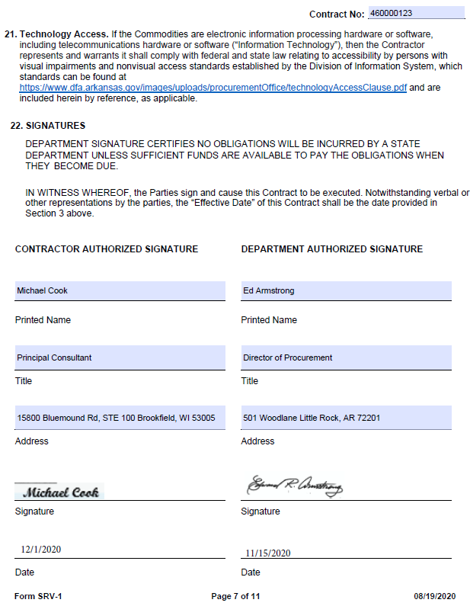
SIGNATURE PAGE
Must be completed and signed/dated by the Department and the Contractor.
(Electronic signatures are accepted.)
Notes:
Contacts should be listed in the order which they should be contacted in the event of questions.

Slide 16
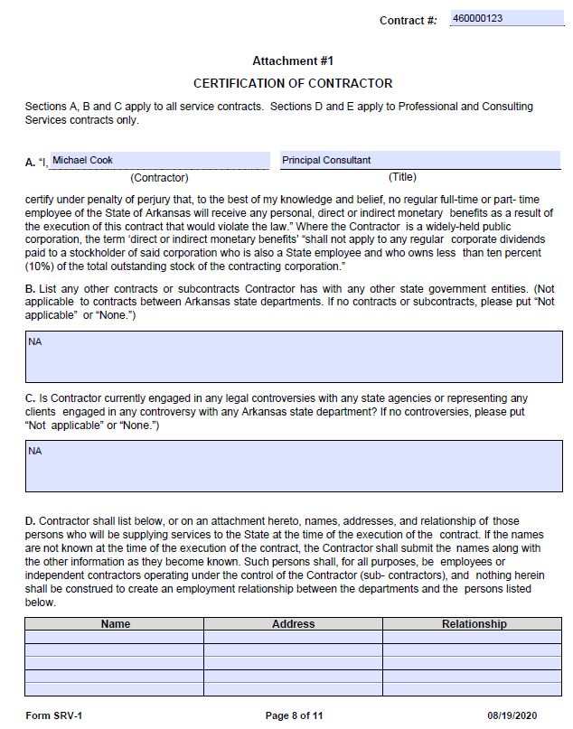
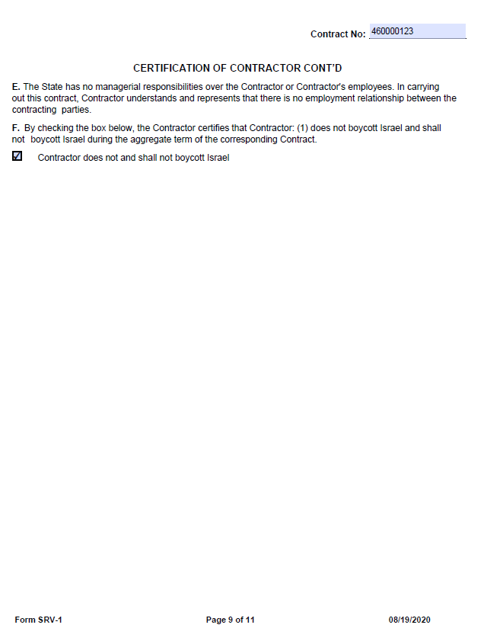
Notes:
Certification of Contractor: These pages should be completed by the vendor.

Slide 17
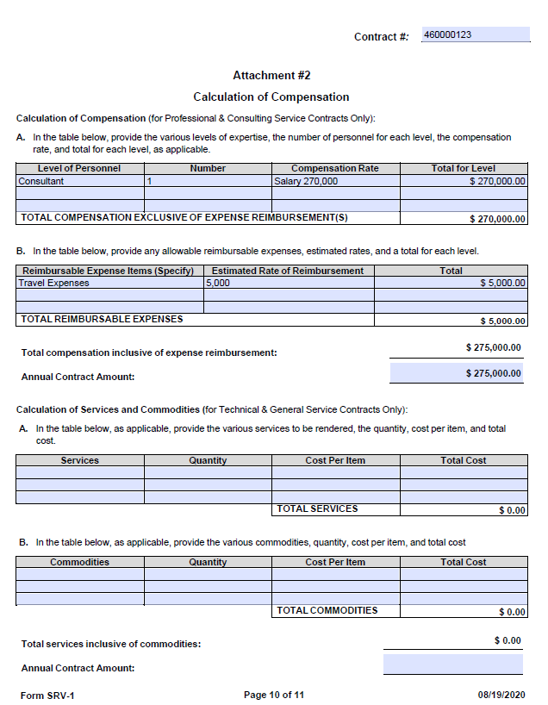
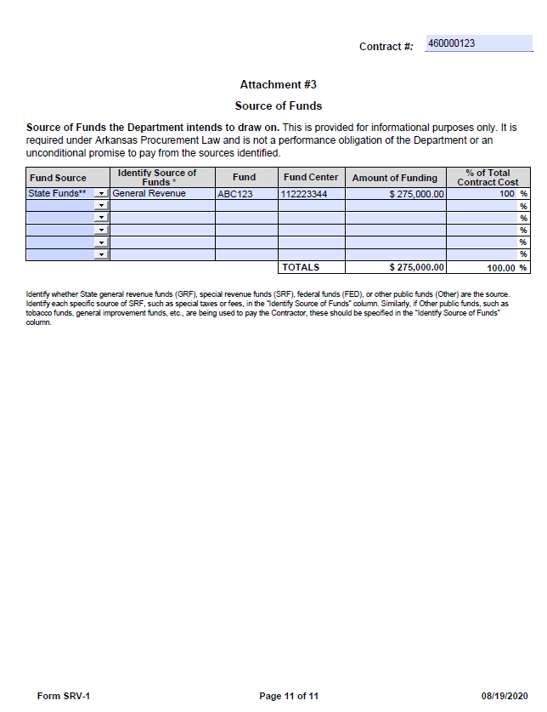
Attachment #2
Top half only applies to PCS contracts.
Bottom half only applies to TGS contracts.
Attachment #3
Provide all details regarding the source of funds.
The total amount of funding must match the total Initial Contract Amount.
Notes:
Calculation of Compensation: The top half of the form (A & B) should be completed for PCS contracts. The bottom half (A & B) should be completed for TGS contracts.
Totals should match the initial contract amount. The annual amount should equal what the agency anticipates to spend in a single year.
Source of Funds: Amount of funding should equal the initial contract amount. Total contract cost should equal 100%.

Slide 18
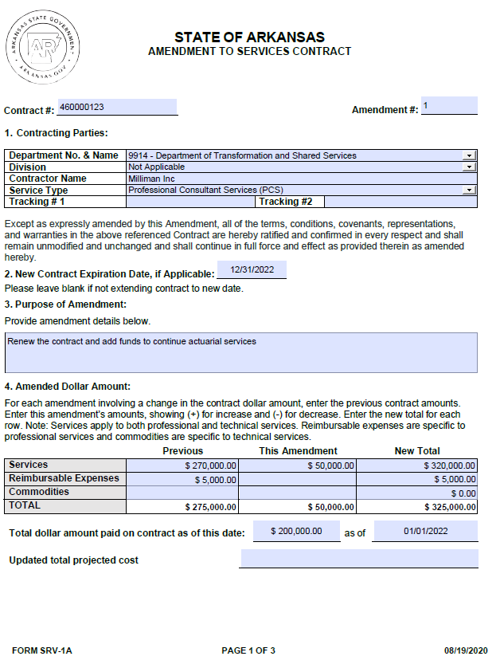
Completing Amendment to Services Contract
SRV-1A FORM
Amendments
  Amendments are for making changes to the original contract
Expiration date
  The expiration date is only required if extending the contract
Purpose of the Amendment
  Provide a brief description of the purpose for the Amendment and include a short description of the services being provided
Amended Dollar Amount
  Enter dollar amount for increase or decrease in funds
Notes:
Amended Dollar Amount: For a PCS contract, complete services and reimbursable expenses. For a TGS contract, complete Services and commodities. Be sure to include the total dollar amount paid and the date.

Slide 19
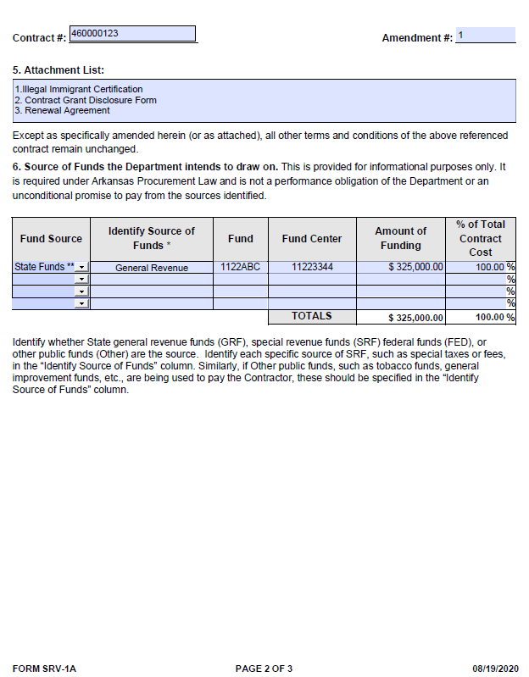
WHERE IS THE MONEY COMING FROM?
Source of Funds
  Fund Source (Federal, State, etc.)
  Identify Source of Funds (specific source: - i.e., special taxes or fees)
  Fund Center
  Amount of funding (must match the “New Total”)
  % of Total Contract Cost (must equal 100%)
Notes:
On amendments signatures are required
Lastly, on the amendment form the Source of Fund will need to be updated to the same amount as your New Compensation Total.

Slide 20
KNOWLEDGE Check
True or False: The amount of funding must match the “New Total” amount on the SRV-1A form?
True
False

Slide 21
KNOWLEDGE Check
True or False: The amount of funding must match the “New Total” amount on the SRV-1A form?
True
False

Slide 22
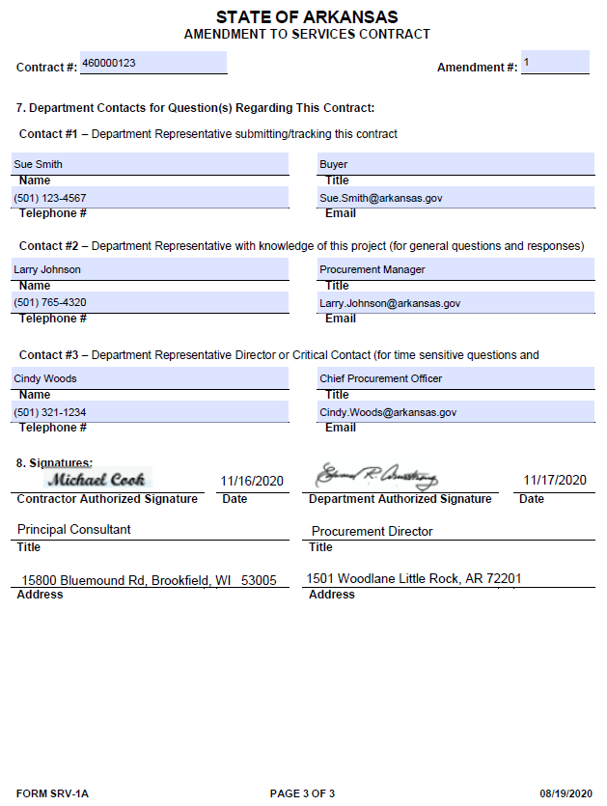
SIGNATURE PAGE
Must be completed and signed/dated by the Department and the Contractor.
(Electronic signatures are accepted.)

Slide 23
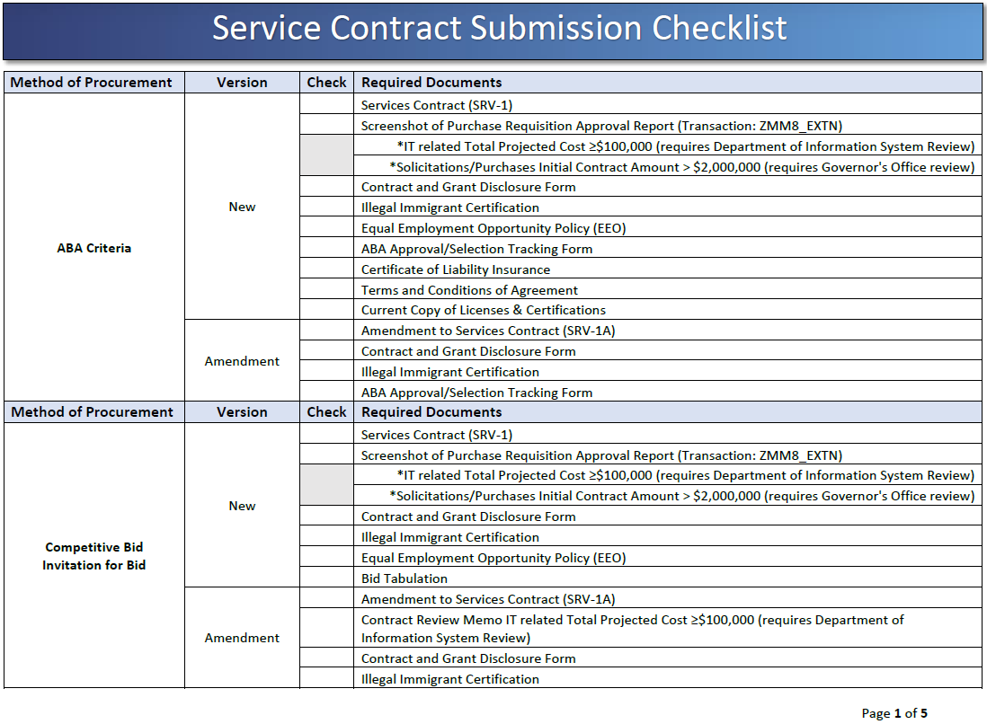
SERVICE CONTRACT CHECKLIST
https://www.transform.ar.gov/wp-content/uploads/2020/08/Service-Contract-Submission-Checklist.pdf
Notes:
HANDOUT
The TGS and PCS check list can be found on the web page under the Helpful Resources link . Each procurement method has a different checklist for originals and amendments.

Slide 24
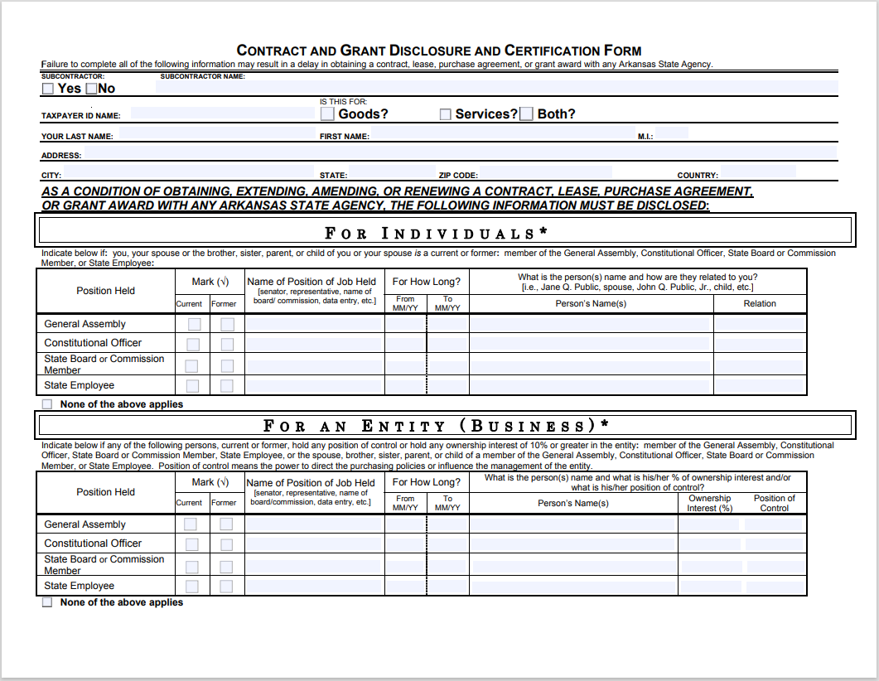
Contract and grant disclosure form

Slide 25
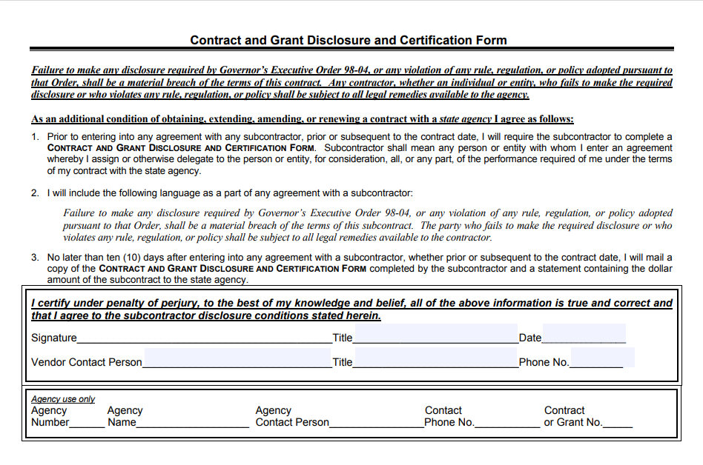
CONTRACT AND GRANT DISCLOSURE FORM - PAGE 2
Notes:
On the contract and grant disclosure form the agency use area is required to be filled in by agency for the reason of if additional questions are needed, we can contract the appropriate person.

Slide 26
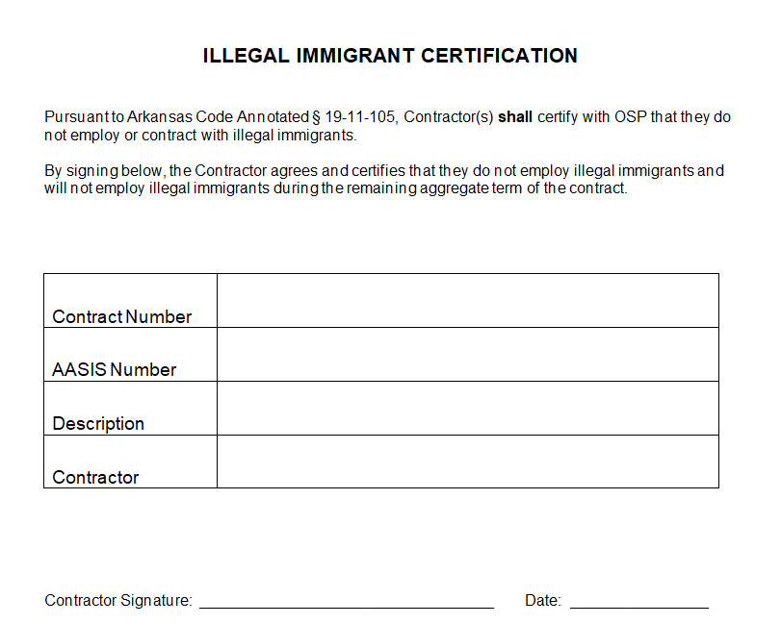
Illegal immigrant certification
Notes:
This form as well as the online illegal immigrant form and the Bid Signature page with the illegal immigrant confirmation can be accepted for illegal immigrant certification.

Slide 27
TOPICS
Services Portal
  Contracts that must be entered into the Portal
  Before Portal Entry
  Creating Portal Entry
  Entry For AASIS Users
  Entry For Non-AASIS Users
  Reviewing Status on Submission

Slide 28
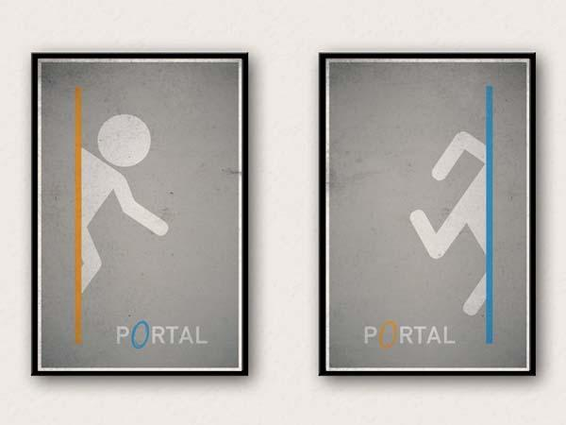
Services Portal

Slide 29
Contracts that must be entered into the Portal
Services means the furnishing of labor, time, or effort by a contractor that does not produce tangible commodities.
A contract for services shall be reported if the total initial contract amount or a total projected contract amount, including any amendments or possible extensions, is at least twenty-five thousand dollars ($25,000) but less than an annual contract amount of fifty thousand dollars ($50,000) in any one (1) contract year or a total projected contract amount is less than three hundred fifty thousand dollars ($350,000).
A contract for services shall be reviewed if the annual contract amount is at least fifty thousand dollars ($50,000) in any one (1) contract year or if the total projected contract amount, including any amendments or possible extensions, is at least three hundred fifty thousand dollars ($350,000).
ACA §19-11-203 (27) (A); 19-11-274 (a); 19-11-265 (a)

Slide 30
KNOWLEDGE Check
Which threshold amounts cause a service contract to have to go for review? Select all that apply
The Annual contract amount is $50,000 or greater
The Annual contract amount is between $25,000- $49,999
The Total Project cost is $350,000 or greater
All the Above

Slide 31
KNOWLEDGE Check
Which threshold amounts cause a service contract to have to go for review? Select all that apply
The Annual contract amount is $50,000 or greater
The Annual contract amount is between $25,000- $49,999
The Total Project cost is $350,000 or greater
All the Above

Slide 32
Before Portal Entry
Non-AASIS Users
Contracts that are going for Review require an attachment. Contracts being reported and reviewed require manual entry.

Slide 33
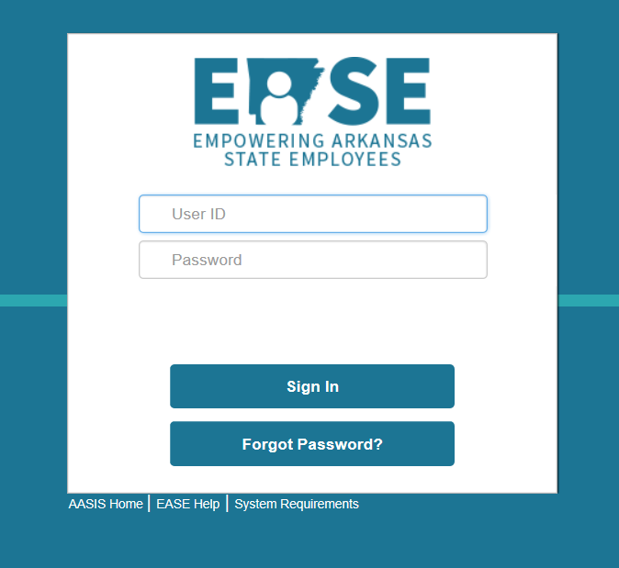
Before Portal Entry
  Before you can enter an OA or PO into the web portal you must have an EASE ID and password with proper authorization. You can contact the AASIS help desk for that authorization and request the following roles 501-683-2255 or aasissecurity@dfa.arkansas.gov and
  request the following roles:
  ES_WDPU_TGS_PCS_USER Role for agency users to enter contracts
  ES_WDPU_VPR_USER Role for agency users to enter VPRs
  Once you have your User ID and Password use the link below to get to the Services Portal:
  Services - Arkansas Department of Transformation and Shared Services
Notes:
Before you can enter an OA or PO into the web portal you must have an EASE ID and password with proper authorization. You can contact the AASIS help desk for that authorization
An outline agreement or PO must be created before you can enter contract into web portal. After you chosen the Total Projected Cost category you can enter your document number. Most of the information in AASIS will auto populate into the web portal. It is important your information in AASIS is correct. If there is an error on your form and AASIS you will have to resubmit the contract in the web portal.
To review a contract that has been submitted into the portal you can choose the Reporting link . The Reporting link is only for reviewing information submitted into the portal you can Not create a submission through this link.

Slide 34
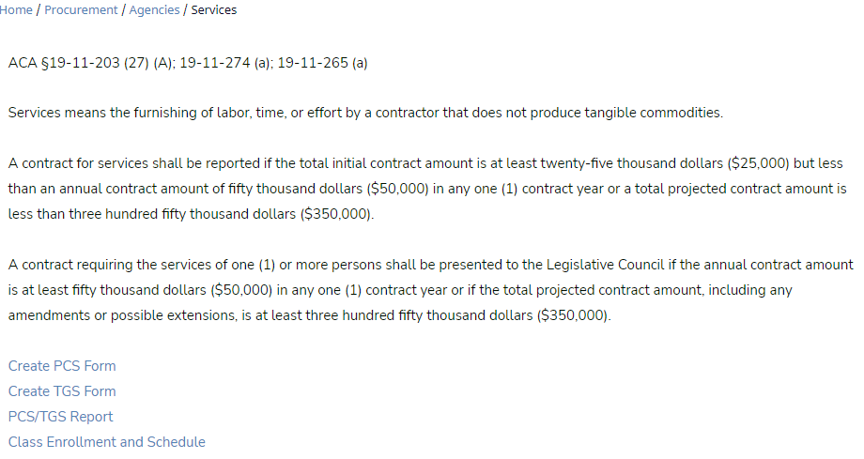
Creating Portal Entry
Select Create PCS or TGS Form
Portal Entry

Slide 35
Entry for NON-AASIS Users
For contract entry complete the following:
Select the Total Projected Cost range amount $25K to less than $350K, or $350K and over.
Annual Contract Amount: enter the annual contract amount for Reporting (this amount is less than $50,000) for Review (this amount is $50,000 or more than)
Document Number: enter the contract number.
Agency: select the agency # and name from the drop down.
Is this an Amendment: for an original contract, select NO. If the entry is an amendment, entry fields will slightly differ.
All information entered into Portal must pass 2-Way Match. All information must be manually entered. If there is an error on your Portal entry, you will have to resubmit the contract in the web portal.
See next slide.

Slide 36
Entry for NON-AASIS Users
Contracts submitted for review must have an attachment that includes all documents required as a single PDF using the following naming convention:
Four (4) digit Agency number/business area_Contract Number_Document Identifier
Example:
0710_4600041898_OR
0710_4600041898_A1

Slide 37
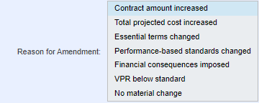
Reason for Amendment
Contracts being amended must indicate the reason for the amendment. See the screen shot below for options and select all that apply by holding the Ctrl key.

Slide 38
Reason for Amendment
Contract amount increased: contracts where the “ This Amendment Amount” is greater than 0.
Total projected cost increased: contracts where the “Total Projected Cost” is greater than the previous stated Total projected cost.
Essential terms changed: change in provisions that must be included for an enforceable contract to exist between the parties under any applicable statute of frauds.
Performance-based standards changed: change in the method of monitoring and evaluating the overall quality of services provided.
Financial consequences imposed: contracts where vendor failure to satisfy performance-based standards increase the cost to the agency.
VPR below Standard: contracts where the vendor has received a below standard VPR from Agency.
No material change: contracts where there is no increase to the contract amount or total projected cost and has no change to the Performance-based standard and Essential term. Do not use if and other reason is selected.

Slide 39
KNOWLEDGE Check
True or False: Amendments can have multiple reasons selected for Reason for Amendment
True
False

Slide 40
KNOWLEDGE Check
True or False: Amendments can have multiple reasons selected for Reason for Amendment
True
False
Press and hold the “ctrl” key to make multiple selections.

Slide 41
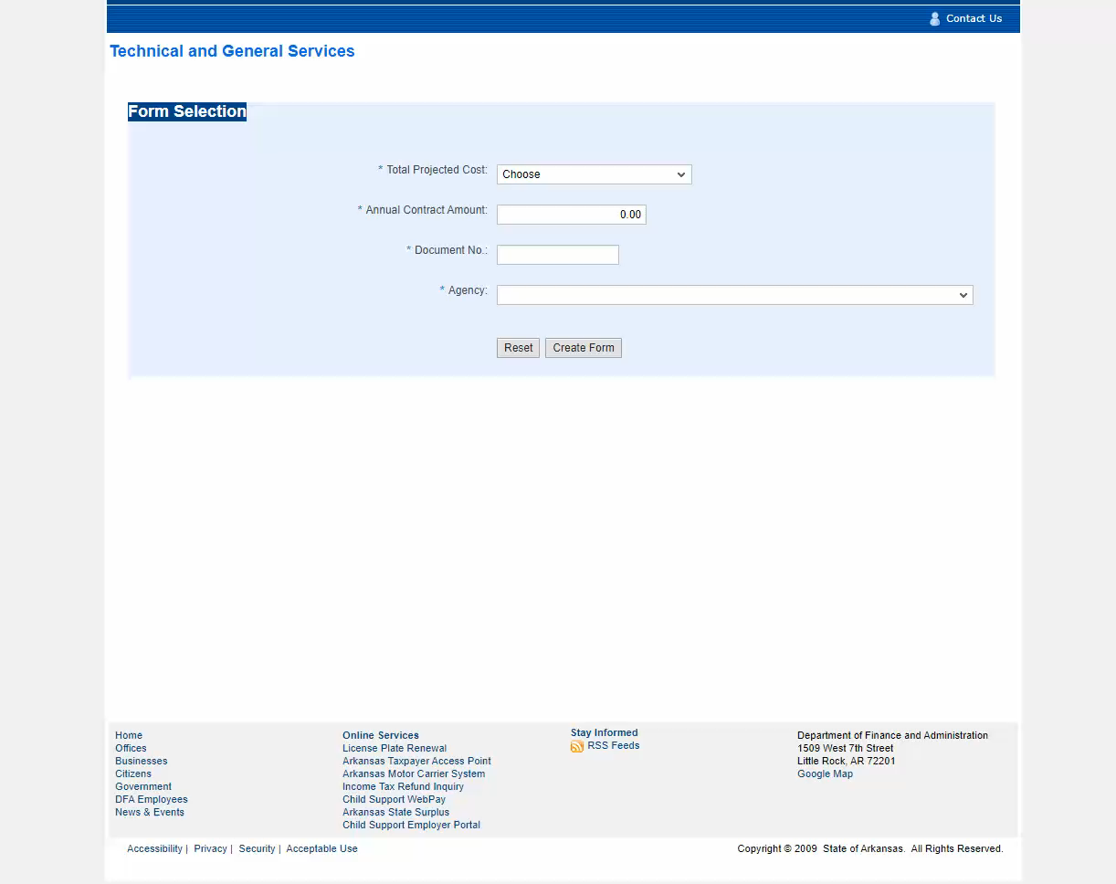

Entry For Original Contracts
NON-AASIS USERS / Minor Contracts
Click on image and press to play video
Notes:
Manual entry is required for Non-AASIS using agencies.

Slide 42
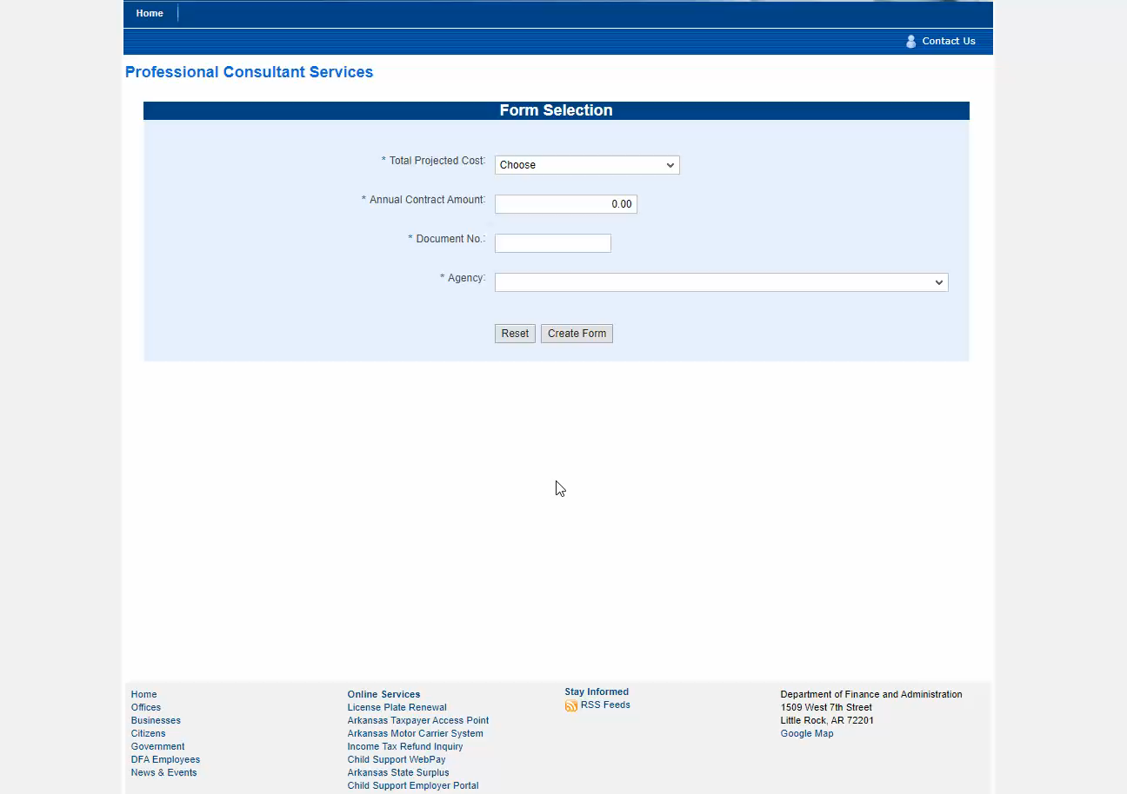
Entry For Amendment
Contracts
NON-AASIS USERS / Minor Contracts
Click on image and press to play video
Notes:
Manual entry is required for Non-AASIS using agencies.

Slide 43

2- Way Match
  Portal and supporting documentation must match
  Amendments and renewals: The Previous Amount should always be the same as previously reviewed contract amount
  After the original contract is submitted, some information will auto-populate
Documentation
Portal
Notes:
The 2-way match applies to non-AASIS agencies such as colleges. The documentation and the portal must match.

Slide 44
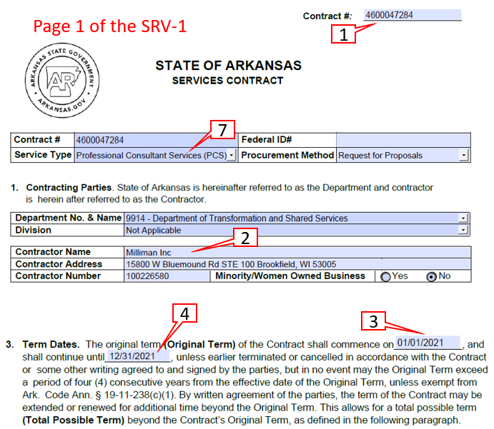
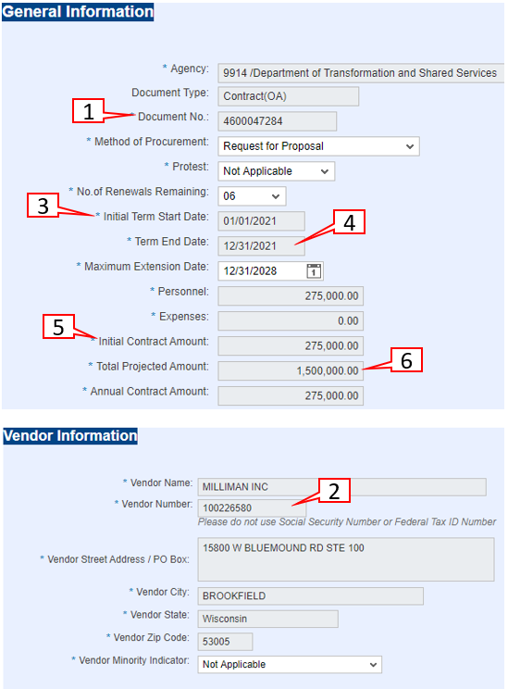
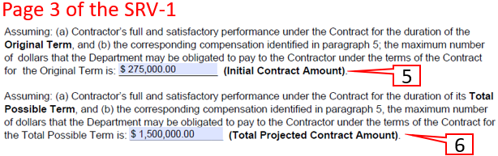
SRV-1 Form
Portal
2-Way Match: Original
KEY:
Contract #
Vendor #
Start Date
End Date
Initial Contract Amount
Total Projected Cost
7) Service Type

Slide 45
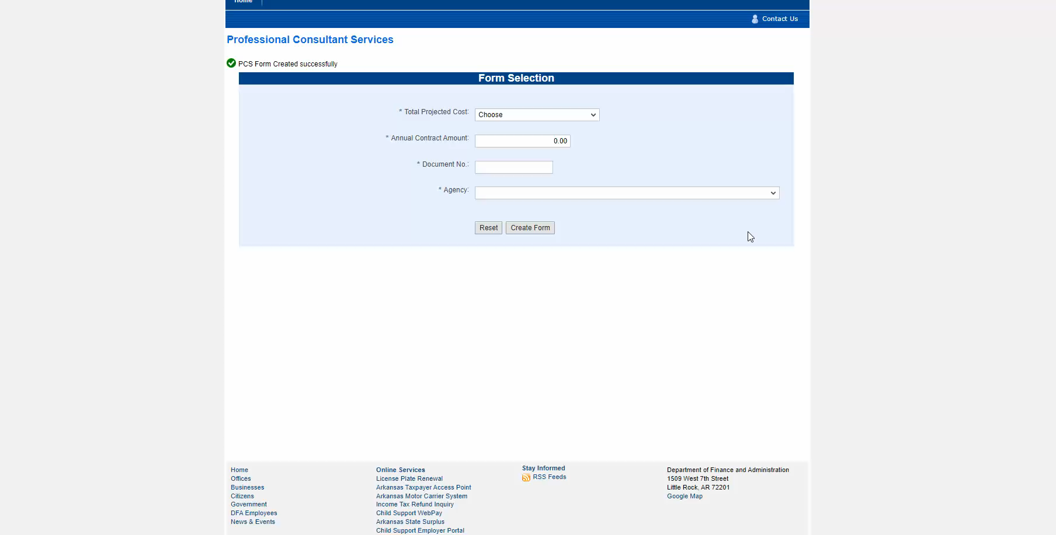
Entry For Original Contracts
NON-AASIS USERS ALC Contracts
Click on image and press to play video
Notes:
Manual entry is required for Non-AASIS using agencies.

Slide 46
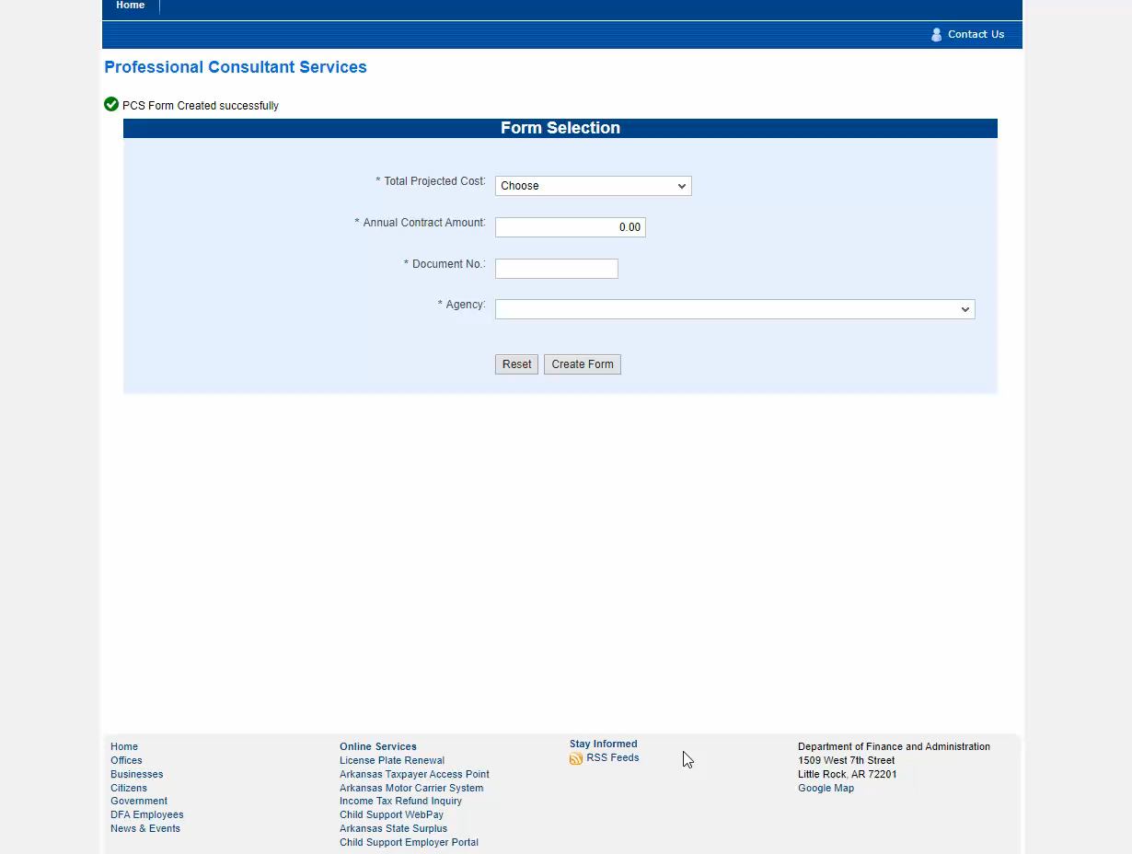
Entry For Amendment
Contracts
NON-AASIS USERS ALC Contracts
Click on image and press to play video
Notes:
Manual entry is required for Non-AASIS using agencies.

Slide 47
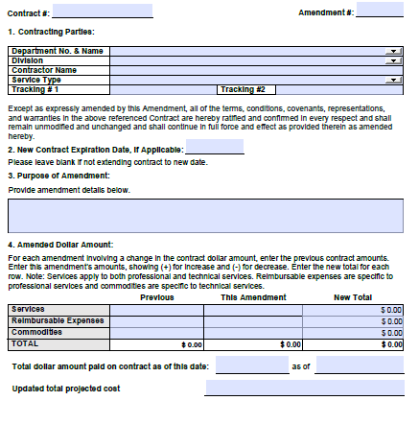
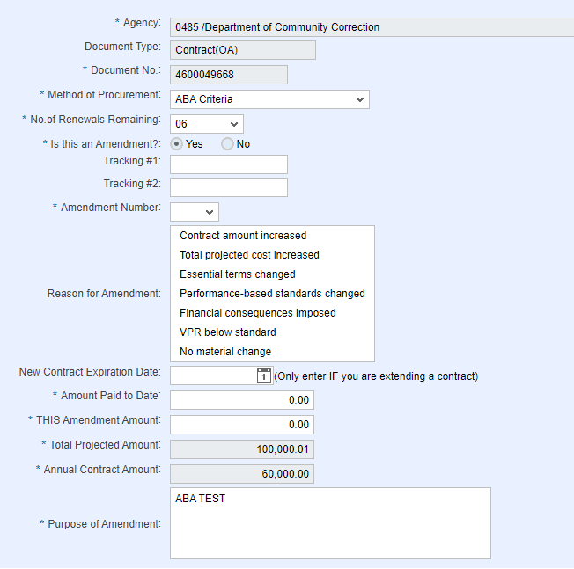
SRV-1 Form
Portal
1
2- Way Match:
Amendment
2
1
KEY:
Contract #
Amendment #
Purpose of Amendment
Amount Paid to Date
THIS Amendment
Total Projected Cost
New contract expiration date if extending
7
2
3
7
4
5
5
6
4
6
3

Slide 48
Reviewing Status on submissions
To review a contract that has been submitted into the portal you can choose the Reporting link . The Reporting link is only for reviewing information submitted into the portal you cannot create a submission through this link.
Contracts that are reported will be released in the Portal once all information is verified as correct. Contracts that must be reviewed will be verified as correct, then placed in Pending ALC review status until review then released.

Slide 49
Report on Portal submissions status
Report for displaying contracts

Slide 50
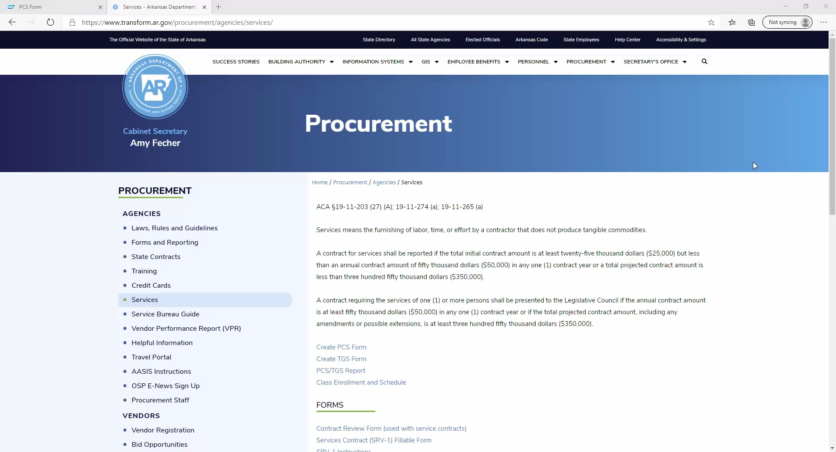
PCS/TGS Report
Click on image and press to play video
Notes:
The PCS/TGS Report is for informational purposes. It is a display of contracts submitted in the portal. The video shows how to display all contracts submitted for an agency. There are multiple ways to generate a report depending on what you are looking for.

Slide 51
OFFICE OF STATE PROCUREMENT
PCS and TGS CONTRACTS
Our Team
Denise Harris – 501-682-0247 - Denise.Harris@arkansas.gov
KiMontie Taller – 501-371-6066 - Kimontie.Taller@arkansas.gov
Melissa Greene – 501-683-0084 - Melissa.Greene@arkansas.gov

