Slide 1
PCS & TGS OVERVIEW

Slide 2
PCS/TGS TRAINING COURSE CONTENT
1.1 AASIS - Getting Started
1.2 TGS/PCS Paperwork
1.3 Services Portal

Slide 3
Introduction
ACA §19-11-203 (27) (A); 19-11-274 (a); 19-11-265 (a)
Services means the furnishing of labor, time, or effort by a contractor that does not produce tangible commodities.
A contract for services shall be reported if the total initial contract amount is at least twenty-five thousand dollars ($25,000) but less than an annual contract amount of fifty thousand dollars ($50,000) in any (1) one contract year or a total projected contract amount is less than three hundred fifty thousand dollars ($350,000).
A contract for services shall be reviewed if the annual contract amount is at least fifty thousand dollars ($50,000) in any (1) one contract year or if the total projected contract amount, including any amendments or possible extensions, is at least three hundred fifty thousand dollars ($350,000).
In this training we will provide information in the following areas to complete a service portal entry.
  AASIS
  PAPERWORK
  PORTAL

Slide 4
KNOWLEDGE Check
True or False: Services are defined as the furnishing of labor, time, or effort by a contractor that does not produce tangible commodities. True False

Slide 5
KNOWLEDGE Check
Services are defined as the furnishing of labor, time, or effort by a contractor that does not produce tangible commodities.
  True
    Professional services are defined as services rendered under a professional services contract are rendered to the state agency itself or to a third-party beneficiary; The state agency does not have direct managerial control over the day-today activities of the individual providing the services.
    Technical and general services are defined as work accomplished by skilled individuals involving time, labor, and a degree of expertise in which performance is evaluated based upon the quality of the work and the results produced.

Slide 6

AASIS
AASIS
Getting Started
  Creating the OA
  Submission into AASIS
  Reporting Categories
  Release Codes

Slide 7
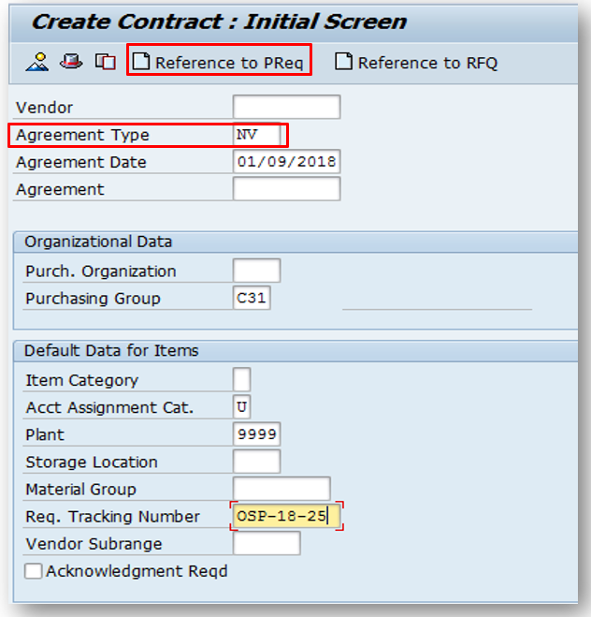
Getting Started – Creating the Outline Agreement
AASIS Transaction ME31K – Create Contract
When creating an Outline Agreement, you should reference your approved PR.
Outline Agreement should reference agreement type
  NV – TGS / PV – PCS
  NB – PO / PB – Prof. PO
AASIS does not apply to Colleges & Universities.
Notes:
When creating an OA you should reference your approved PR this will allow the information on the PR to transfer over to the outline agreement. For TGS OA’s use the agreement type NV and for Prof. Svc. OA use the agreement type PV. AASIS transactions do not apply to Colleges and Universities

Slide 8
Getting Started – Creating the Outline Agreement
When creating an Outline Agreements (OA) , you should reference your approved purchase requisition (PR). This will allow the information on the PR to transfer over to the OA.
For TGS OA’s use the agreement type NV, and for Prof. Svc. OA, use the agreement type PV.
AASIS transactions do not apply to Colleges and Universities

Slide 9
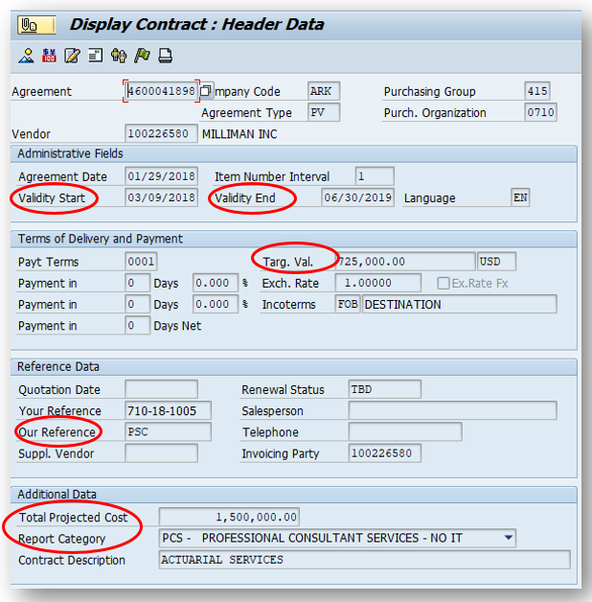
SUBMISSION INTO AASIS
KEY FIELDS
Key fields are reviewed when portal administrators process contracts:
Validity Start Date (Do NOT change)
Validity End Date
Target Value (This should equal the total line items)
Our Reference
Total Projected Cost
(TPC should include any amendments/extensions)
Report Category

Slide 10
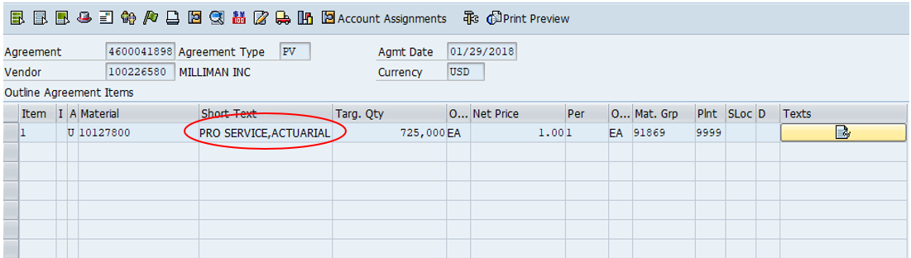
SUBMISSION INTO AASIS (continued)
Line items should match service type:
Examples:
PCS = PRO SERVICE
TGS = TECH SERVICE
Once the OA is created, you will receive a 46000 number. Your total projected cost (TPC) AND the annual contract amount will determine if the contract should be reported or reviewed.

Slide 11
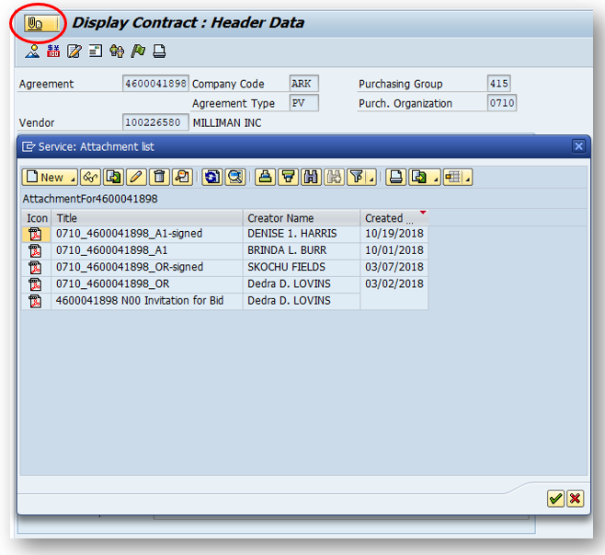
Create attachment including all documents required for submission as a single PDF using the following naming convention:
Four (4) digit agency number/business area_Contract Number_Document Identifier
Example:
0710_4600041898_OR
0710_4600041898_A1
Changes to the attachment can only be made by the creator if there are no releases.
If an attachment cannot be deleted, upload a new attachment using the file naming convention_Revised
Example:
0710_4600041898_OR Revised
Before you enter your information into the Service portal you will need to make sure AASIS match the information on the form.

Slide 12
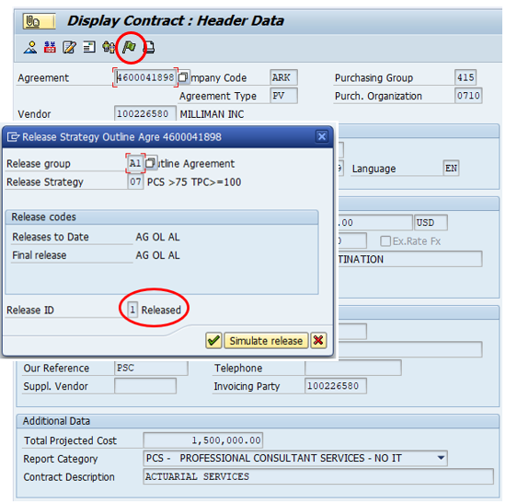
Check Release Strategy
If the Release ID shows “Blocked” the contract still requires releases.
If the Release ID shows “Released” the contract is approved.

Slide 13
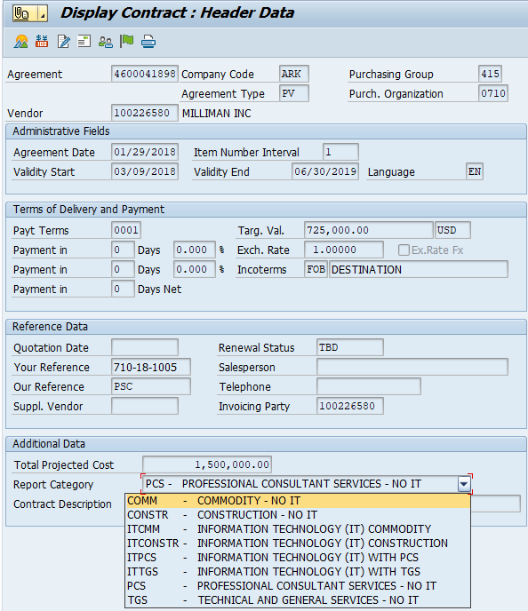
Reporting Categories
Report category is assigned by AASIS depending on the material number
Verify the material number selected matches the report category (if your report cat. does not match your procurement method choose a different material number)
The report category will help determine what type of contract it is such as TGS or PCS.
Notes:
Your purchase document can have a combination of different line items each belonging to a different reporting category. This is a list of rules on how to assign the appropriate reporting category value for the purchasing documents.
If you have an OA created with multiple line items, and it contains PCS and TGS the Report category will automatically default to PCS.

Slide 14
Reporting Categories
IT Constr
Constr
ITPCS
PCS
ITTGS
TGS
ITCOMM
COMM
IT Construction – requires DIS & DBA approval
Construction related No IT contract – requires DBA approval
IT Professional Consultant Serv - requires DIS & DBA approval
Professional Consultant Serv. No IT – requires OSP approval
IT Technical and General - requires DIS & DBA approval
Technical and General Serv. No IT - requires OSP approval
IT Commodity - requires DIS & OSP approval
Commodity No IT - requires OSP approval before usage
Notes:
Your purchase document can have a combination of different line items each belonging to a different reporting category. This is a list of rules on how to assign the appropriate reporting category value for the purchasing documents.
If you have an OA created with multiple line items, and it contains PCS and TGS the Report category will automatically default to PCS.

Slide 15
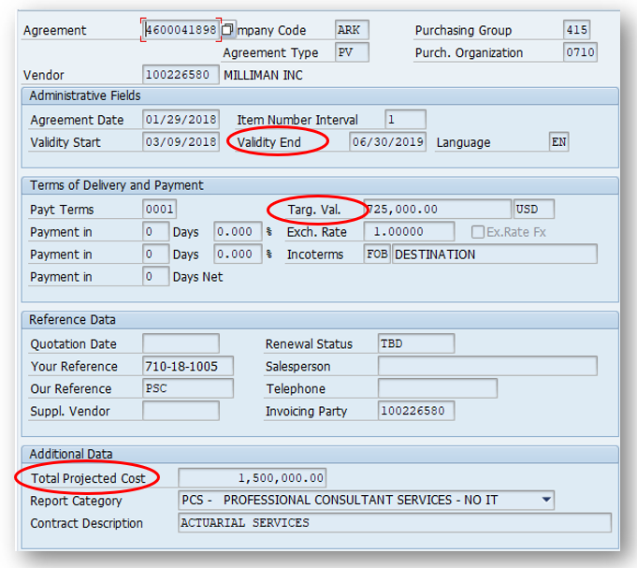
What resets the release codes?
Changing the validity dates
Changing line-item value(s)
Updating the Total Projected Cost

Slide 16
KNOWLEDGE Check
Which is NOT a way to reset the releases indicators in AASIS?
Changing the validity dates
Changing line-items values
Adding a new attachment
Updating the Total Projected Cost

Slide 17
KNOWLEDGE Check
You can not reset the releases indicators in AASIS.
Adding a new attachment
To reset the release indicators, you must change the validity end date / line- items values / increase the target value / increase the total projected cost

Slide 18
Release Codes
AASIS Code | Portal Status | Meaning
 | Released | Contract has been executed and ready for usage
AG | Pending Agency Approval | Needs to be released by the Agency director.
AL | Pending ALC Review | Ready for ALC to review and will stay in this status until after the ALC final meeting
DP | Pending DBA PCS Review | (Building Authority) is reviewing the ABA Criteria contract and needs to be released by the DBA staff (Leland Dyson or Nathan Alderson)
DS | Pending DIS Review | DIS is reviewing contract and released by DIS staff
OD | Pending OSP Director Review | OSP Director needs to release.
OL | Pending OSP Final Review | OSP Contract staff needs to release, or the contract has a hit on the contract and grant disclosure form, hasn't started working on contract
OM | Pending OSP Manager Review | OSP Manager releases. If is an OSP buyer's contract, the buyer's manager will do the release
OP | Pending OSP Portal Review | OSP Contract staff is reviewing the submission or hasn't started working it.
Helpful Information:
It is the agency’s responsibility to check the status of the contract.
If your contract is not in one of these statuses “OP,” “OL,” “AL” we are not responsible for checking those.
Please contact the appropriate parties if your contract remains the same status for more than 4 days.
Notes:
When checking the release strategy on an OA these are the following codes. Some of the ones on the left are not applicable for ALC contracts. If there is a code that should not be on your OA you we need to check your line item and makes sure you have used the current material number.

Slide 19
PCS/TGS PAPERWORK
TGS/PCS Paperwork
  Completion of the SRV-1 & SRV-1A
  Additional Documentation Required

Slide 20


Services contract (SRV) FORM
WHICH FORM SHOULD I USE?
This Photo by Unknown Author is licensed under CC BY-NC

Slide 21
SRV-1 AND SRV-1A
THE SRV-1 form (formerly known as PCS/TGS-1) should be completed for original (new) contracts
THE SRV-1A form (formerly known as PCS/TGS-1A) should be completed for amendments.
Use the link below to access these forms, instructions, helpful resources, etc.
Services - Arkansas Department of Transformation and Shared Services

Slide 22
KNOWLEDGE Check
Which Services form is used for original contracts? SRV-1 SRV-1A

Slide 23
KNOWLEDGE Check
On an original contracts you must use the
  SRV-1
      The SRV-1A form is used with amendments or renewals.

Slide 24
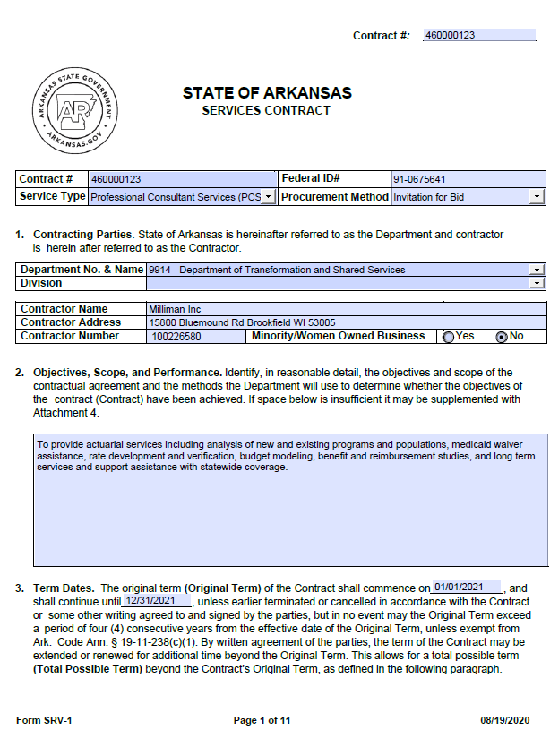
SRV-1 form
Must be completed for original contracts submitted to the portal.
Services-Contract-SRV-1-Instructi vice
COMPLETING THE SRV FORM
COMMON ERRORS:
The contractor number is the AASIS vendor number, not the contractor’s phone number.
The original term of the contract may not exceed four consecutive years from the effective date of the contract. ACA §19-11-238
The maximum extension date may not exceed seven years. ACA §19-11-238
Notes:
Instructions for completing the fields are provided on the OSP website under the Services section - Services-Contract-SRV-1-Instructions.pdf (ar.gov)

Slide 25
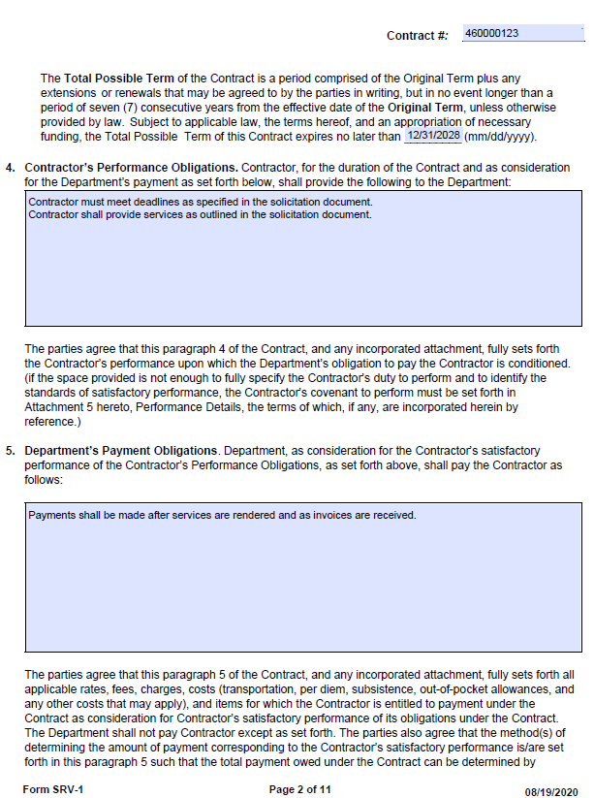
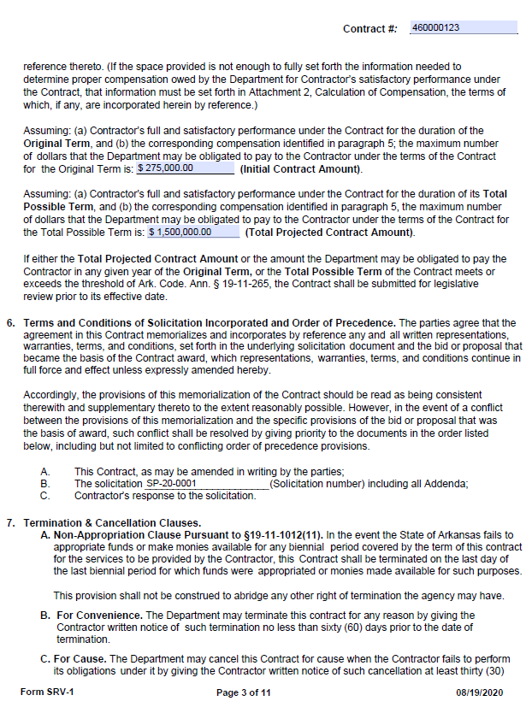
Notes:
Contractor’s Performance Obligations: This should include acceptable performance standards.
Department’s Payment Obligations: This should include the agency’s payment schedule or other payment obligations.
Initial Contract Amount: This should equal the total line items in AASIS and the target value.
Total Projected Amount: This should include the initial amount plus any potential amendments and extensions.
Solicitation Number: This is the identifying characters assigned to the solicitation document.

Slide 26
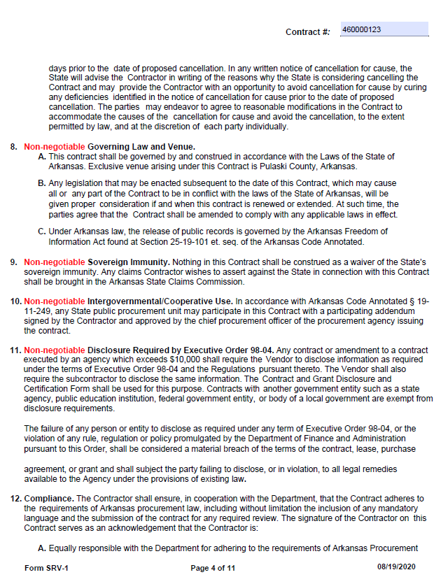
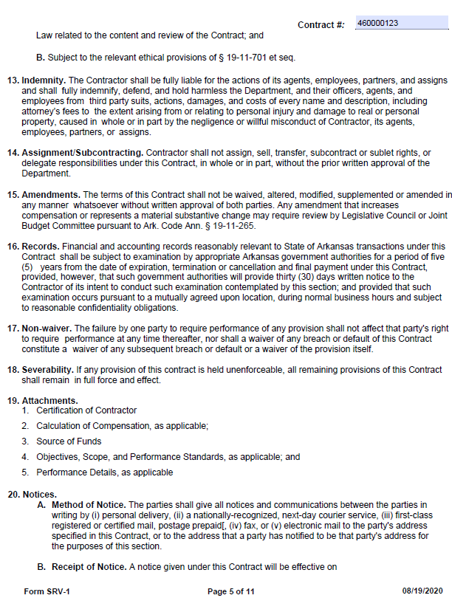
Notes:
Pages 4 & 5 include standard contract language. No fields required for entry.

Slide 27
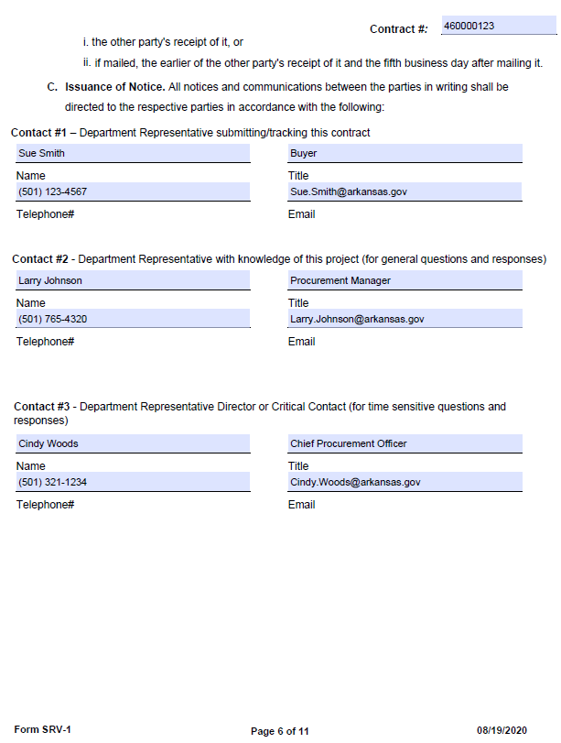
AGENCY CONTACT INFORMATION
Contact information must be provided in case there is a question concerning the contract.
Notes:
Contacts should be listed in the order which they should be contacted in the event of questions.

Slide 28
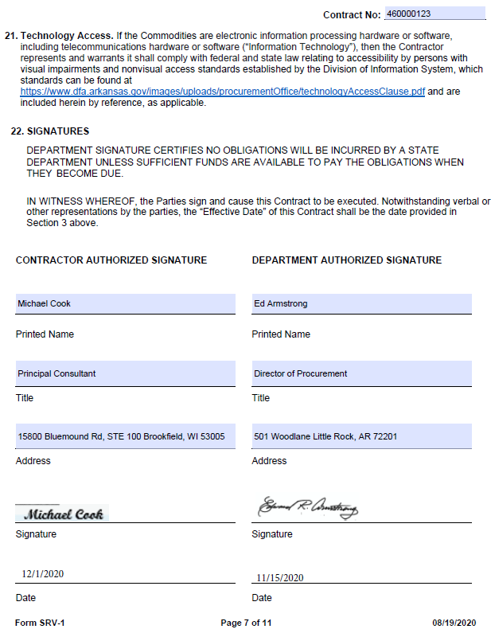
SIGNATURE PAGE
Must be completed and signed/dated by the Department and the Contractor.
(Electronic signatures are accepted.)
Notes:
Contacts should be listed in the order which they should be contacted in the event of questions.

Slide 29
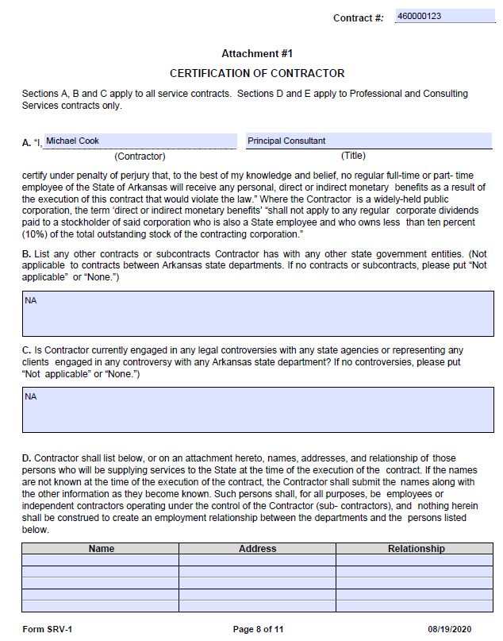
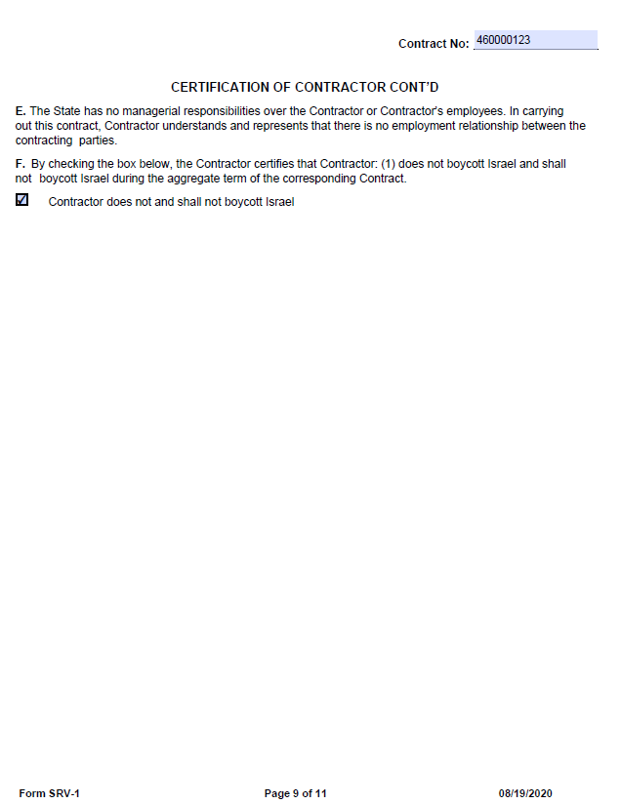
Notes:
Certification of Contractor: These pages should be completed by the vendor.

Slide 30
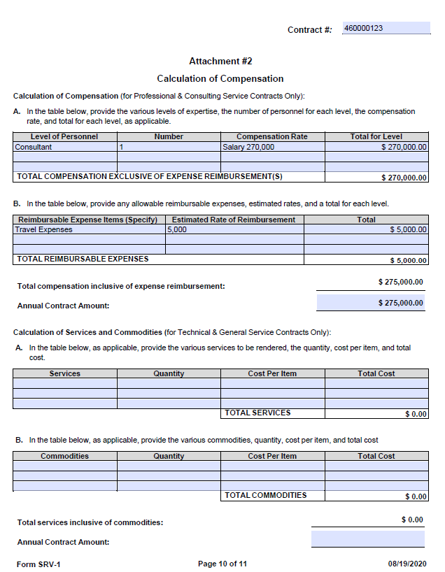
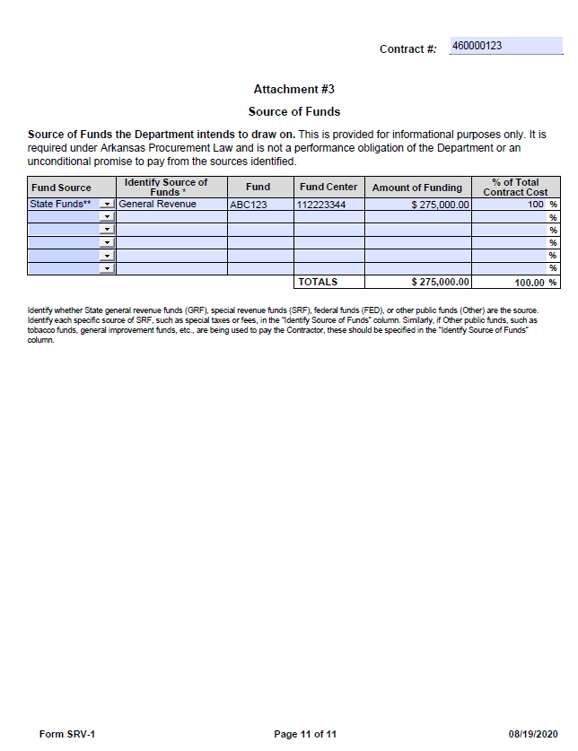
Attachment #2
Top half of form applies to PCS contracts.
Bottom half of form applies to TGS contracts.
Attachment #3
Provide all details regarding the source of funds.
The total amount of funding must match the total Initial Contract Amount.
Notes:
Calculation of Compensation: The top half of the form (A & B) should be completed for PCS contracts. The bottom half (A & B) should be completed for TGS contracts.
Totals should match the initial contract amount. The annual amount should equal what the agency anticipates to spend in a single year.
Source of Funds: Amount of funding should equal the initial contract amount. Total contract cost should equal 100%.

Slide 31
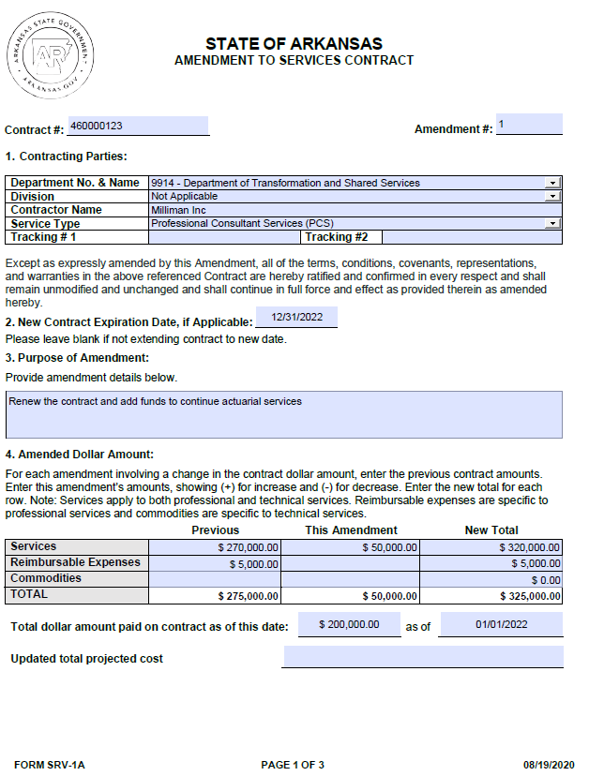
Completing Amendment to Services Contract
SRV-1A FORM
Amendments
  Amendments are for making changes to the original contract
Expiration date
  The expiration date is only required if extending the contract
Purpose of the Amendment
  Provide a brief description of the purpose for the Amendment and include a short description of the services being provided
Amended Dollar Amount
  Enter dollar amount for increase or decrease in funds
Notes:
Amended Dollar Amount: For a PCS contract, complete services and reimbursable expenses. For a TGS contract, complete Services and commodities. Be sure to include the total dollar amount paid and the date.

Slide 32
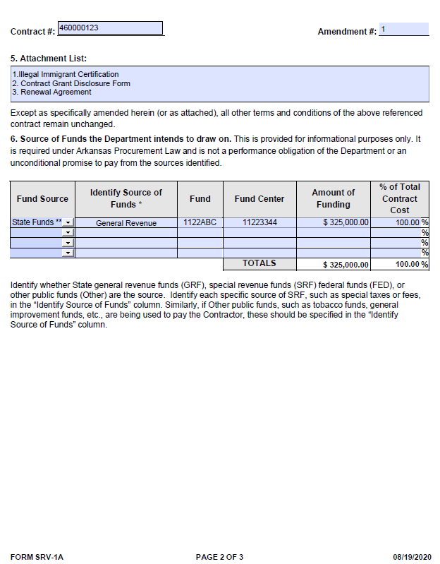
WHERE IS THE MONEY COMING FROM?
Source of Funds
  Fund Source (Federal, State, etc.)
  Identify Source of Funds (specific source: - i.e., special taxes or fees)
  Fund Center
  Amount of funding (must match the “New Total”)
  % of Total Contract Cost (must equal 100%)
Notes:
On amendments signatures are required
Lastly, on the amendment form the Source of Fund will need to be updated to the same amount as your New Compensation Total.

Slide 33
KNOWLEDGE Check
True or False: The amount of funding must match the “New Total” amount on the SRV-1A form?
True
False

Slide 34
KNOWLEDGE Check
True or False: The amount of funding must match the “New Total” amount on the SRV-1A form?
True
False

Slide 35
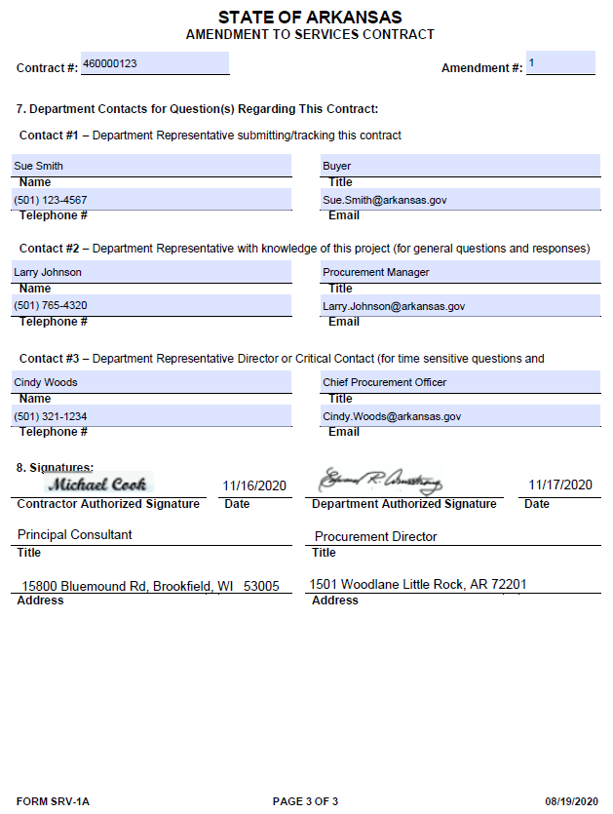
SIGNATURE PAGE
Must be completed and signed/dated by the Department and the Contractor.
(Electronic signatures are accepted.)

Slide 36
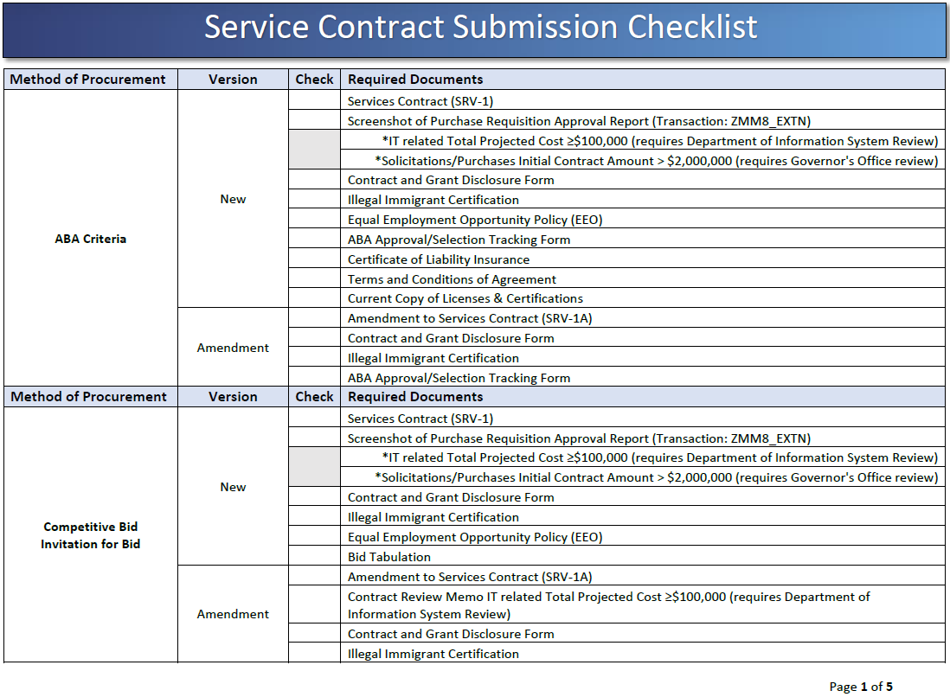
SERVICE CONTRACT CHECKLIST
https://www.transform.ar.gov/wp-content/uploads/2020/08/Service-Contract-Submission-Checklist.pdf
Notes:
HANDOUT
The TGS and PCS check list can be found on the web page under the Helpful Resources link . Each procurement method has a different checklist for originals and amendments.

Slide 37
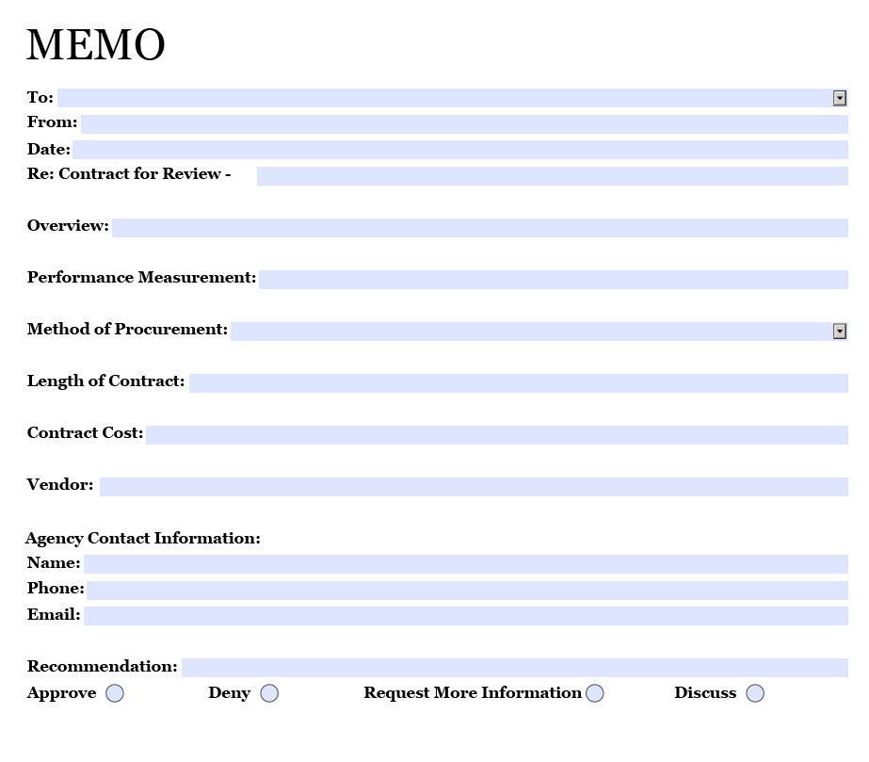
Contract Review Form
Contract Review Form
Required for all IT contracts with a value of $100,000 or more
Provides a summary of the contract information
The form is located on the OSP website under Procurement Forms and Reporting

Slide 38
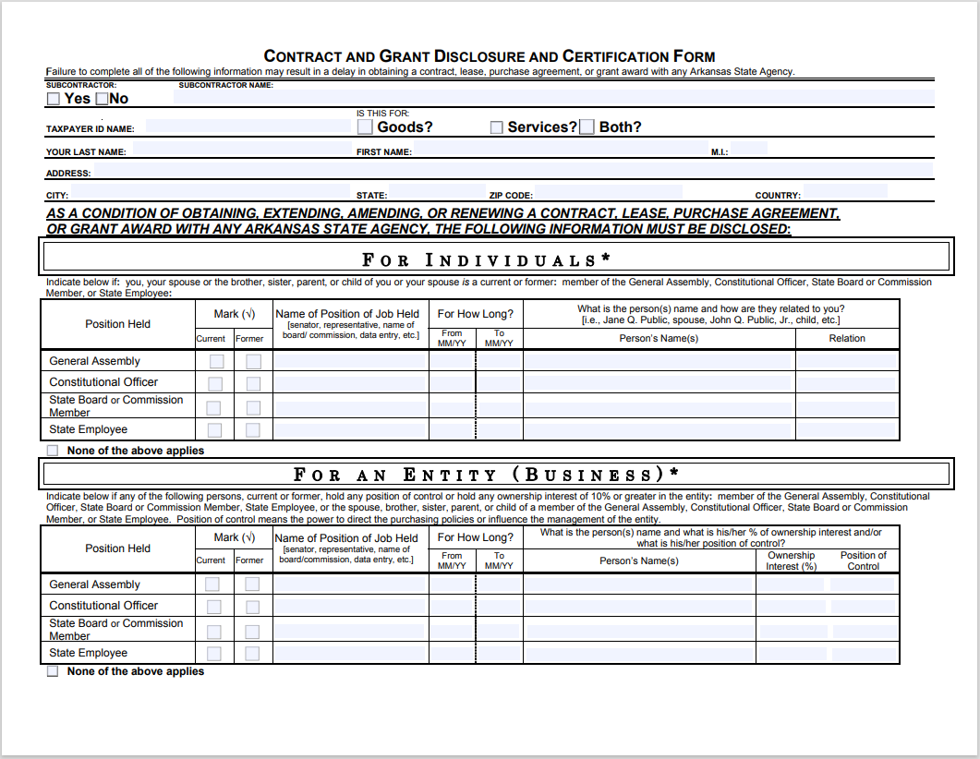
Contract and grant disclosure form

Slide 39
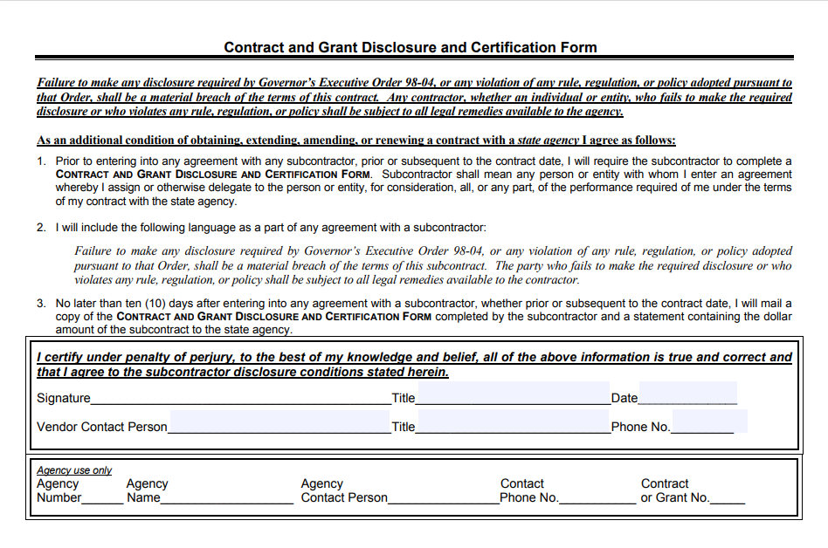
CONTRACT AND GRANT DISCLOSURE FORM - PAGE 2
Notes:
On the contract and grant disclosure form the agency use area is required to be filled in by agency for the reason of if additional questions are needed, we can contract the appropriate person.

Slide 40
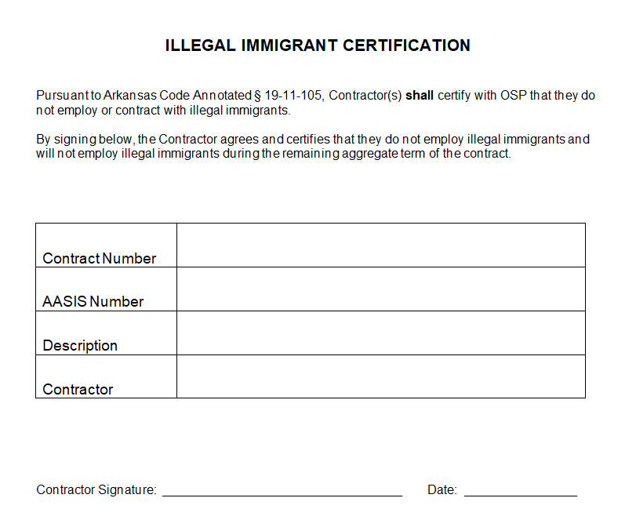
Illegal immigrant certification
Notes:
This form as well as the online illegal immigrant form and the Bid Signature page with the illegal immigrant confirmation can be accepted for illegal immigrant certification.

Slide 41
TOPICS
Services Portal
  Contracts that must be entered into the Portal
  Before Portal Entry
  Creating Portal Entry
  Entry For AASIS Users
  Entry For Non-AASIS Users
  Reviewing Status on Submission

Slide 42
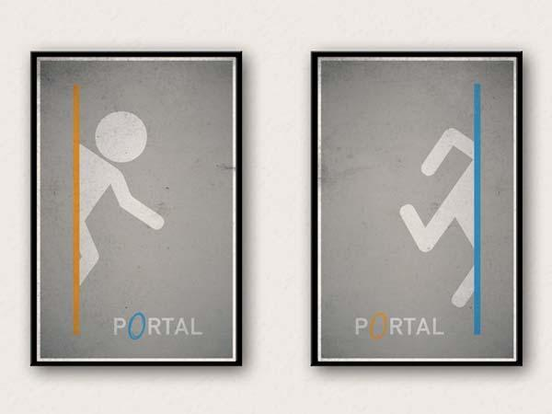
Services Portal

Slide 43
Contracts that must be entered into the Portal
Services means the furnishing of labor, time, or effort by a contractor that does not produce tangible commodities.
A contract for services shall be reported if the total initial contract amount or a total projected contract amount, including any amendments or possible extensions, is at least twenty-five thousand dollars ($25,000) but less than an annual contract amount of fifty thousand dollars ($50,000) in any one (1) contract year or a total projected contract amount is less than three hundred fifty thousand dollars ($350,000).
A contract for services shall be reviewed if the annual contract amount is at least fifty thousand dollars ($50,000) in any one (1) contract year or if the total projected contract amount, including any amendments or possible extensions, is at least three hundred fifty thousand dollars ($350,000).
ACA §19-11-203 (27) (A); 19-11-274 (a); 19-11-265 (a)

Slide 44
KNOWLEDGE Check
Which threshold amounts require a service contract to have to go for review? Select all that apply
The Annual contract amount is $50,000 or greater
The Annual contract amount is between $25,000- $49,999
The Total Project cost is $350,000 or greater
All the Above

Slide 45
KNOWLEDGE CHECK
Which threshold amounts require a service contract to have to go for review? Select all that apply
The Annual contract amount is $50,000 or greater
The Annual contract amount is between $25,000- $49,999
The Total Project cost is $350,000 or greater
All the Above

Slide 46
Before Portal Entry
AASIS Users
An Outline Agreement or Purchase Order must be created before you can enter contract into web portal.

Slide 47
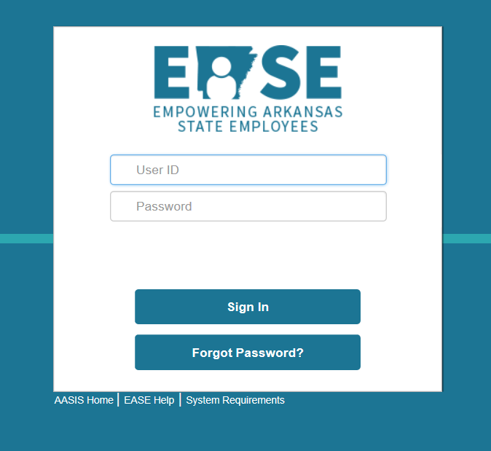
Before Portal Entry
  Before you can enter an OA or PO into the web portal you must have an EASE ID and password with proper authorization. You can contact the AASIS help desk for that authorization at request the following roles 501-683-2255 or aasissecurity@dfa.arkansas.gov and request the following roles:
  ES_WDPU_TGS_PCS_USER Role for agency users to enter contracts
  ES_WDPU_VPR_USER Role for agency users to enter VPRs
  Once you have your User ID and Password use the link below to get to the Services Portal:
  Services - Arkansas Department of Transformation and Shared Services
Notes:
Before you can enter an OA or PO into the web portal you must have an EASE ID and password with proper authorization. You can contact the AASIS help desk for that authorization
An outline agreement or PO must be created before you can enter contract into web portal. After you chosen the Total Projected Cost category you can enter your document number. Most of the information in AASIS will auto populate into the web portal. It is important your information in AASIS is correct. If there is an error on your form and AASIS you will have to resubmit the contract in the web portal.
To review a contract that has been submitted into the portal you can choose the Reporting link . The Reporting link is only for reviewing information submitted into the portal you can Not create a submission through this link.

Slide 48
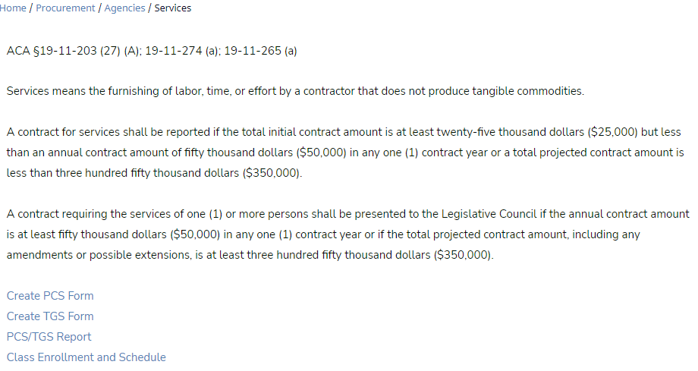
Creating Portal Entry
Select Create PCS or TGS Form
Portal Entry

Slide 49
Entry for AASIS Users
For contract Entry complete the following:
Select the Total Projected Cost range: amount $25K to less than $350K, or $350K and over.
Annual Contract Amount: enter the annual contract amount for Reporting (this amount is less than $50,000) for Review (this amount is $50,000 or more than).
Document Number: enter the contract number.
Agency: Select the agency # and name from the drop down
Is this an Amendment: for an original contract, select NO. If the entry is an amendment, entry fields will slightly differ
All information entered into Portal must pass 3-Way Match. Most of the information in AASIS will auto populate into the web portal. It is important your information in AASIS is correct. If there is an error on your form and AASIS you will have to resubmit the contract in the web portal.

Slide 50
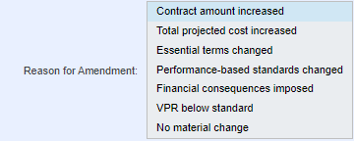
Reason for Amendment
Contracts being amended must indicate the reason for the amendment. See the screen shot below for options and select all that apply. Press and hold the “ctrl” key to make multiple selections.

Slide 51
Reason for Amendment (Cont’d)
Contract amount increased: contracts where the “ This Amendment Amount” is greater than 0.
Total projected cost increased: contracts where the “Total Projected Cost” is greater than the previous stated Total projected cost.
Essential terms changed: change in provisions that must be included for an enforceable contract to exist between the parties under any applicable statute of frauds.
Performance-based standards changed: change in the method of monitoring and evaluating the overall quality of services provided.
Financial consequences imposed: contracts where vendor failure to satisfy performance-based standards increase the cost to the agency.
VPR below Standard: contracts where the vendor has received a below standard VPR from Agency.
No material change: contracts where there is no increase to the contract amount or total projected cost and has no change to the Performance-based standard and Essential term. Do not use if and other reason is selected.

Slide 52
KNOWLEDGE Check
True or False: Amendments can have multiple reasons selected for Reason for Amendment
True
False

Slide 53
KNOWLEDGE Check
True or False: Amendments can have multiple reasons selected for Reason for Amendment
True
False
Press and hold the “ctrl” key to make multiple selections.

Slide 54
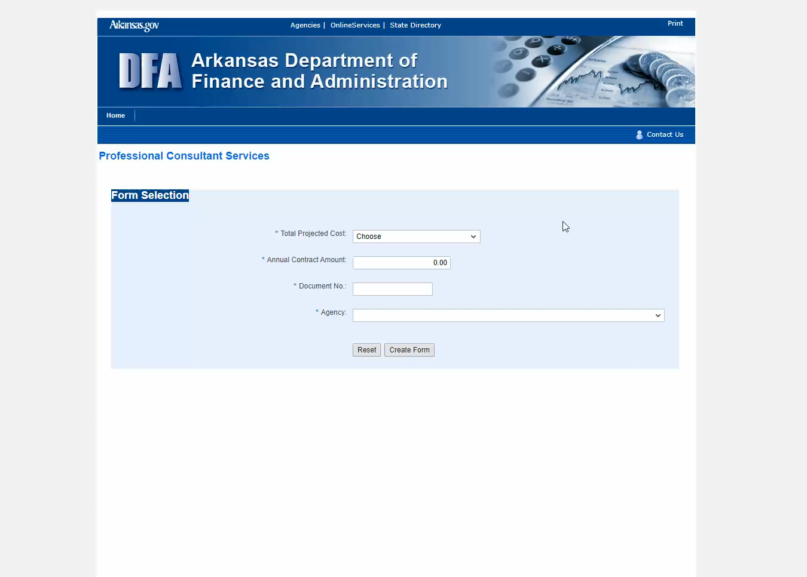

Entry For Original Contracts
AASIS USERS / Minor Contracts
Click on image and press to play video
Notes:
For reporting complete the following:
Total Projected Cost: Amount 25K to less than 350K
Annual Contract Amount: Enter the annual contract amount (this should be less than $50,000)
Document Number: Enter the contract number
Agency: Select the agency # and name from the drop down
Is this an Amendment: For an original contract, select NO. If the entry is an amendment, entry fields will slightly differ

Slide 55
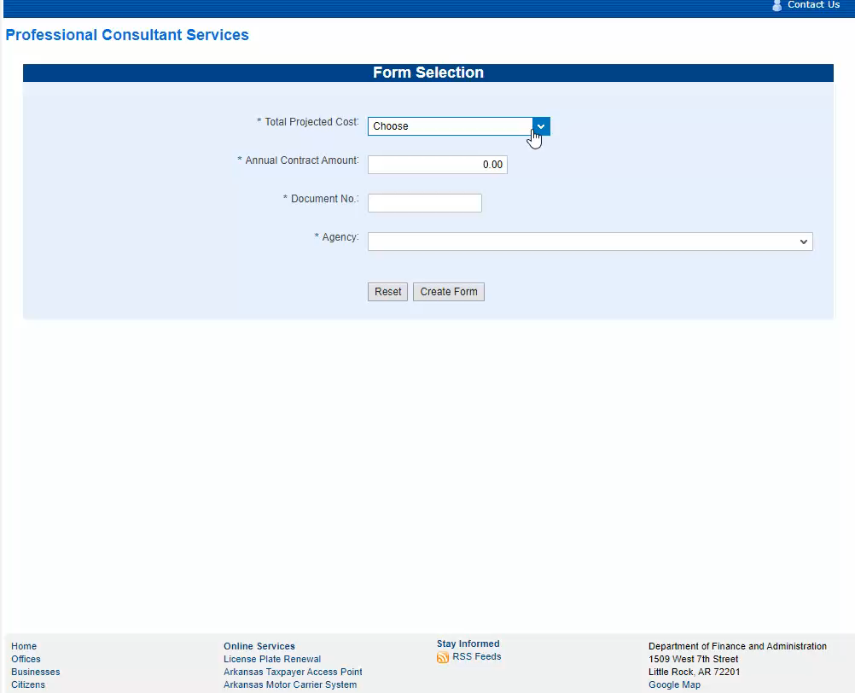
Entry For Amendment Contracts
AASIS USERS / Minor
Contracts
Click on image and press to play video

Slide 56

3- Way Match
AASIS
Documentation
Portal
AASIS should always be updated before entering into the portal
AASIS, the Portal, and supporting documentation must match
Target value must match the amount listed in Source of Funds
Report Category should align with the material descriptions
The following fields in the portal will auto populate from AASIS:
  Validity Dates
  Initial Contract Amount
  Total Projected Cost
  Vendor Information
  Amendments and renewals: The Previous Amount should always be the same as previously reviewed contract amount
Notes:
The 3-way match applies the AASIS users. AASIS, documentation, and portal entry must all match.

Slide 57
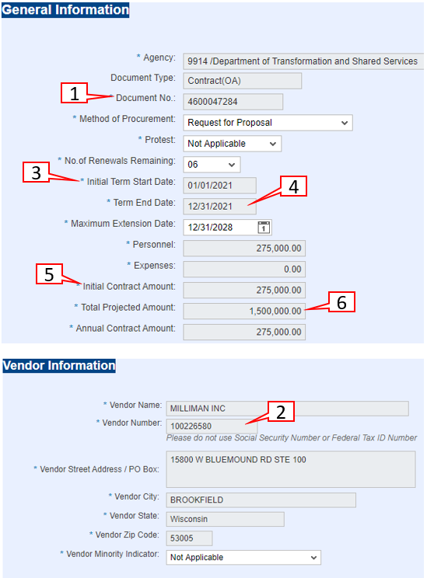
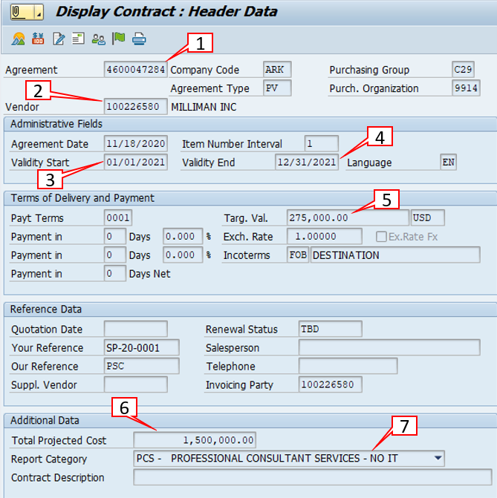
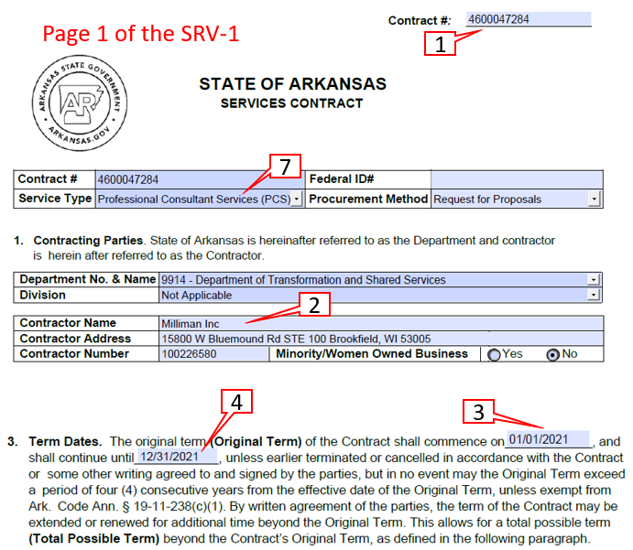
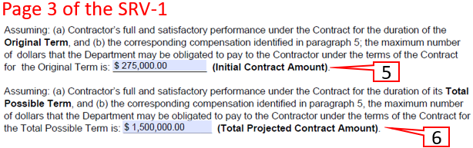
AASIS
SRV-1 Form
KEY:
Contract #
Vendor #
Start Date
End Date
Initial Contract Amount (Target Value in AASIS)
Total Projected Cost
7) Service Type (Report Category in AASIS)
Portal
3- Way Match: Original
Notes:
Scope (Update)

Slide 58
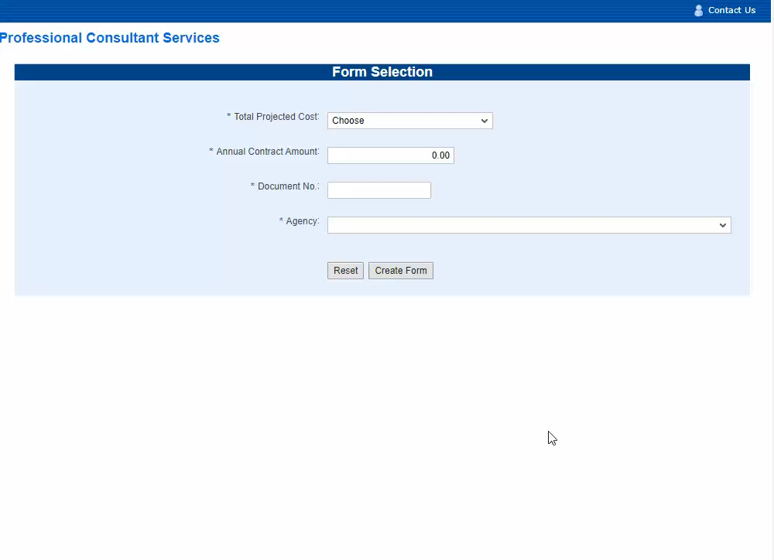
ORIGINAL ALC CONTRACT ENTRY FOR
AASIS USERS
Click on image and press to play video

Slide 59
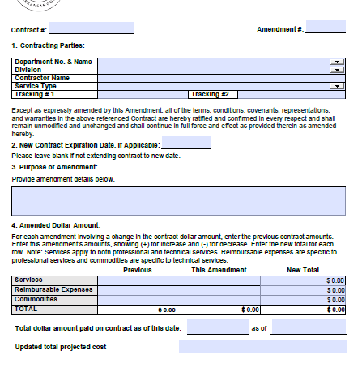
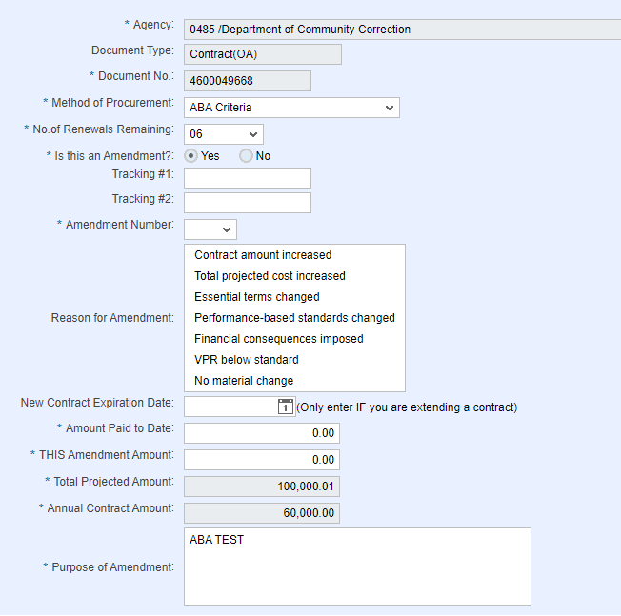
1
2
1
7
2
3
7
5
4
5
4
6
3
6
AASIS
SRV-1A Form
KEY:
Contract #
Amendment #
Purpose of Amendment
Amount Paid to Date
THIS Amendment
Total Projected Cost
New contract expiration date if extending
Portal
3- Way Match: Amendment
Notes:
Scope (Update)

Slide 60
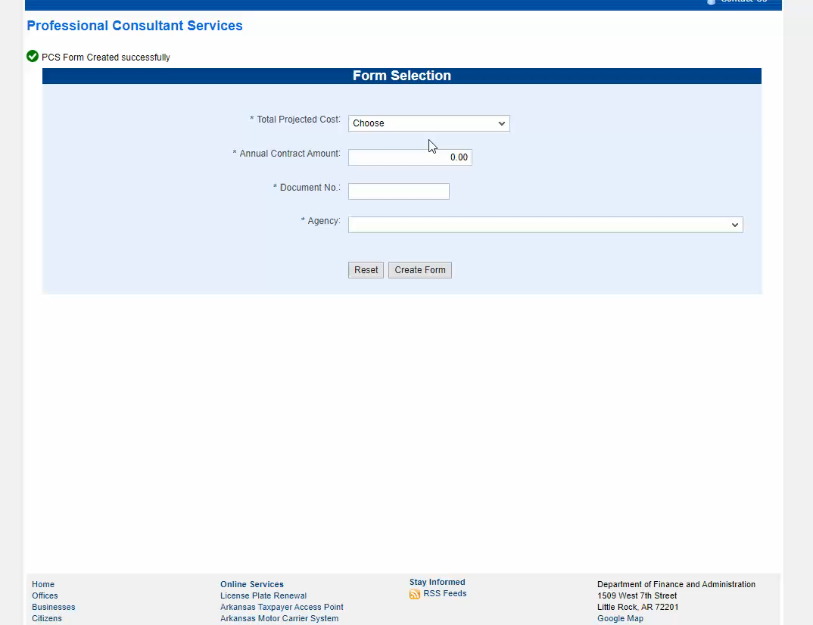
AMENDMENT ALC CONTRACT ENTRY FOR
AASIS USERS
Click on image and press to play video

Slide 61
Reviewing Status on submissions
To review a contract that has been submitted into the portal you can choose the Reporting link . The Reporting link is only for reviewing information submitted into the portal you cannot create a submission through this link.
Contracts that are reported will be released in the Portal once all information is verified as correct. Contracts that must be reviewed will be verified as correct, then placed in Pending ALC review status until review then released.

Slide 62
Report on Portal submissions status
Report for displaying contracts

Slide 63
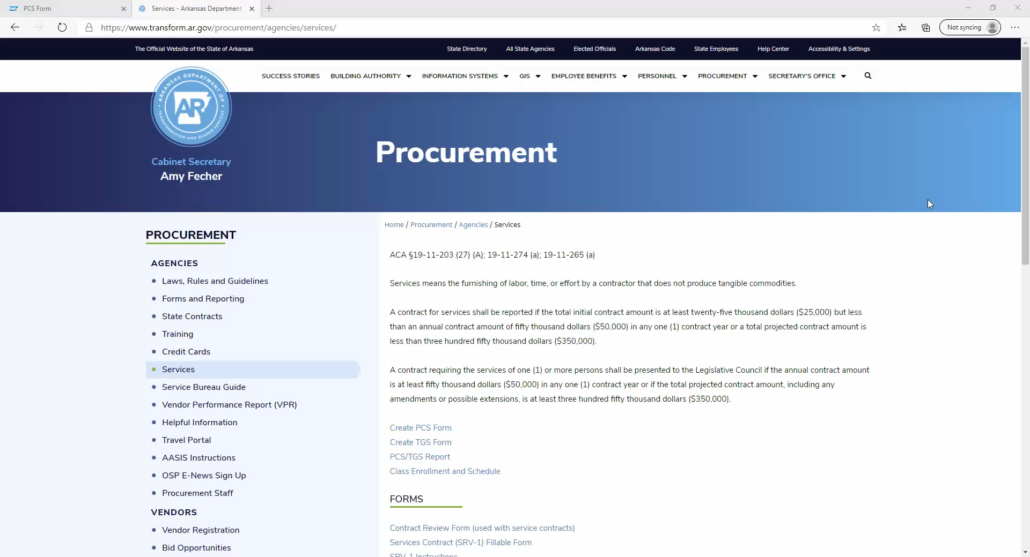
PCS/TGS Report
Click on image and press to play video
Notes:
The PCS/TGS Report is for informational purposes. It is a display of contracts submitted in the portal. The video shows how to display all contracts submitted for an agency. There are multiple ways to generate a report depending on what you are looking for.

Slide 64
OFFICE OF STATE PROCUREMENT
PCS and TGS CONTRACTS
Our Team
Denise Harris – 501-682-0247 - Denise.Harris@arkansas.gov
KiMontie Taller – 501-371-6066 - Kimontie.Taller@arkansas.gov
Melissa Greene – 501-683-0084 - Melissa.Greene@arkansas.gov

